Slide 1

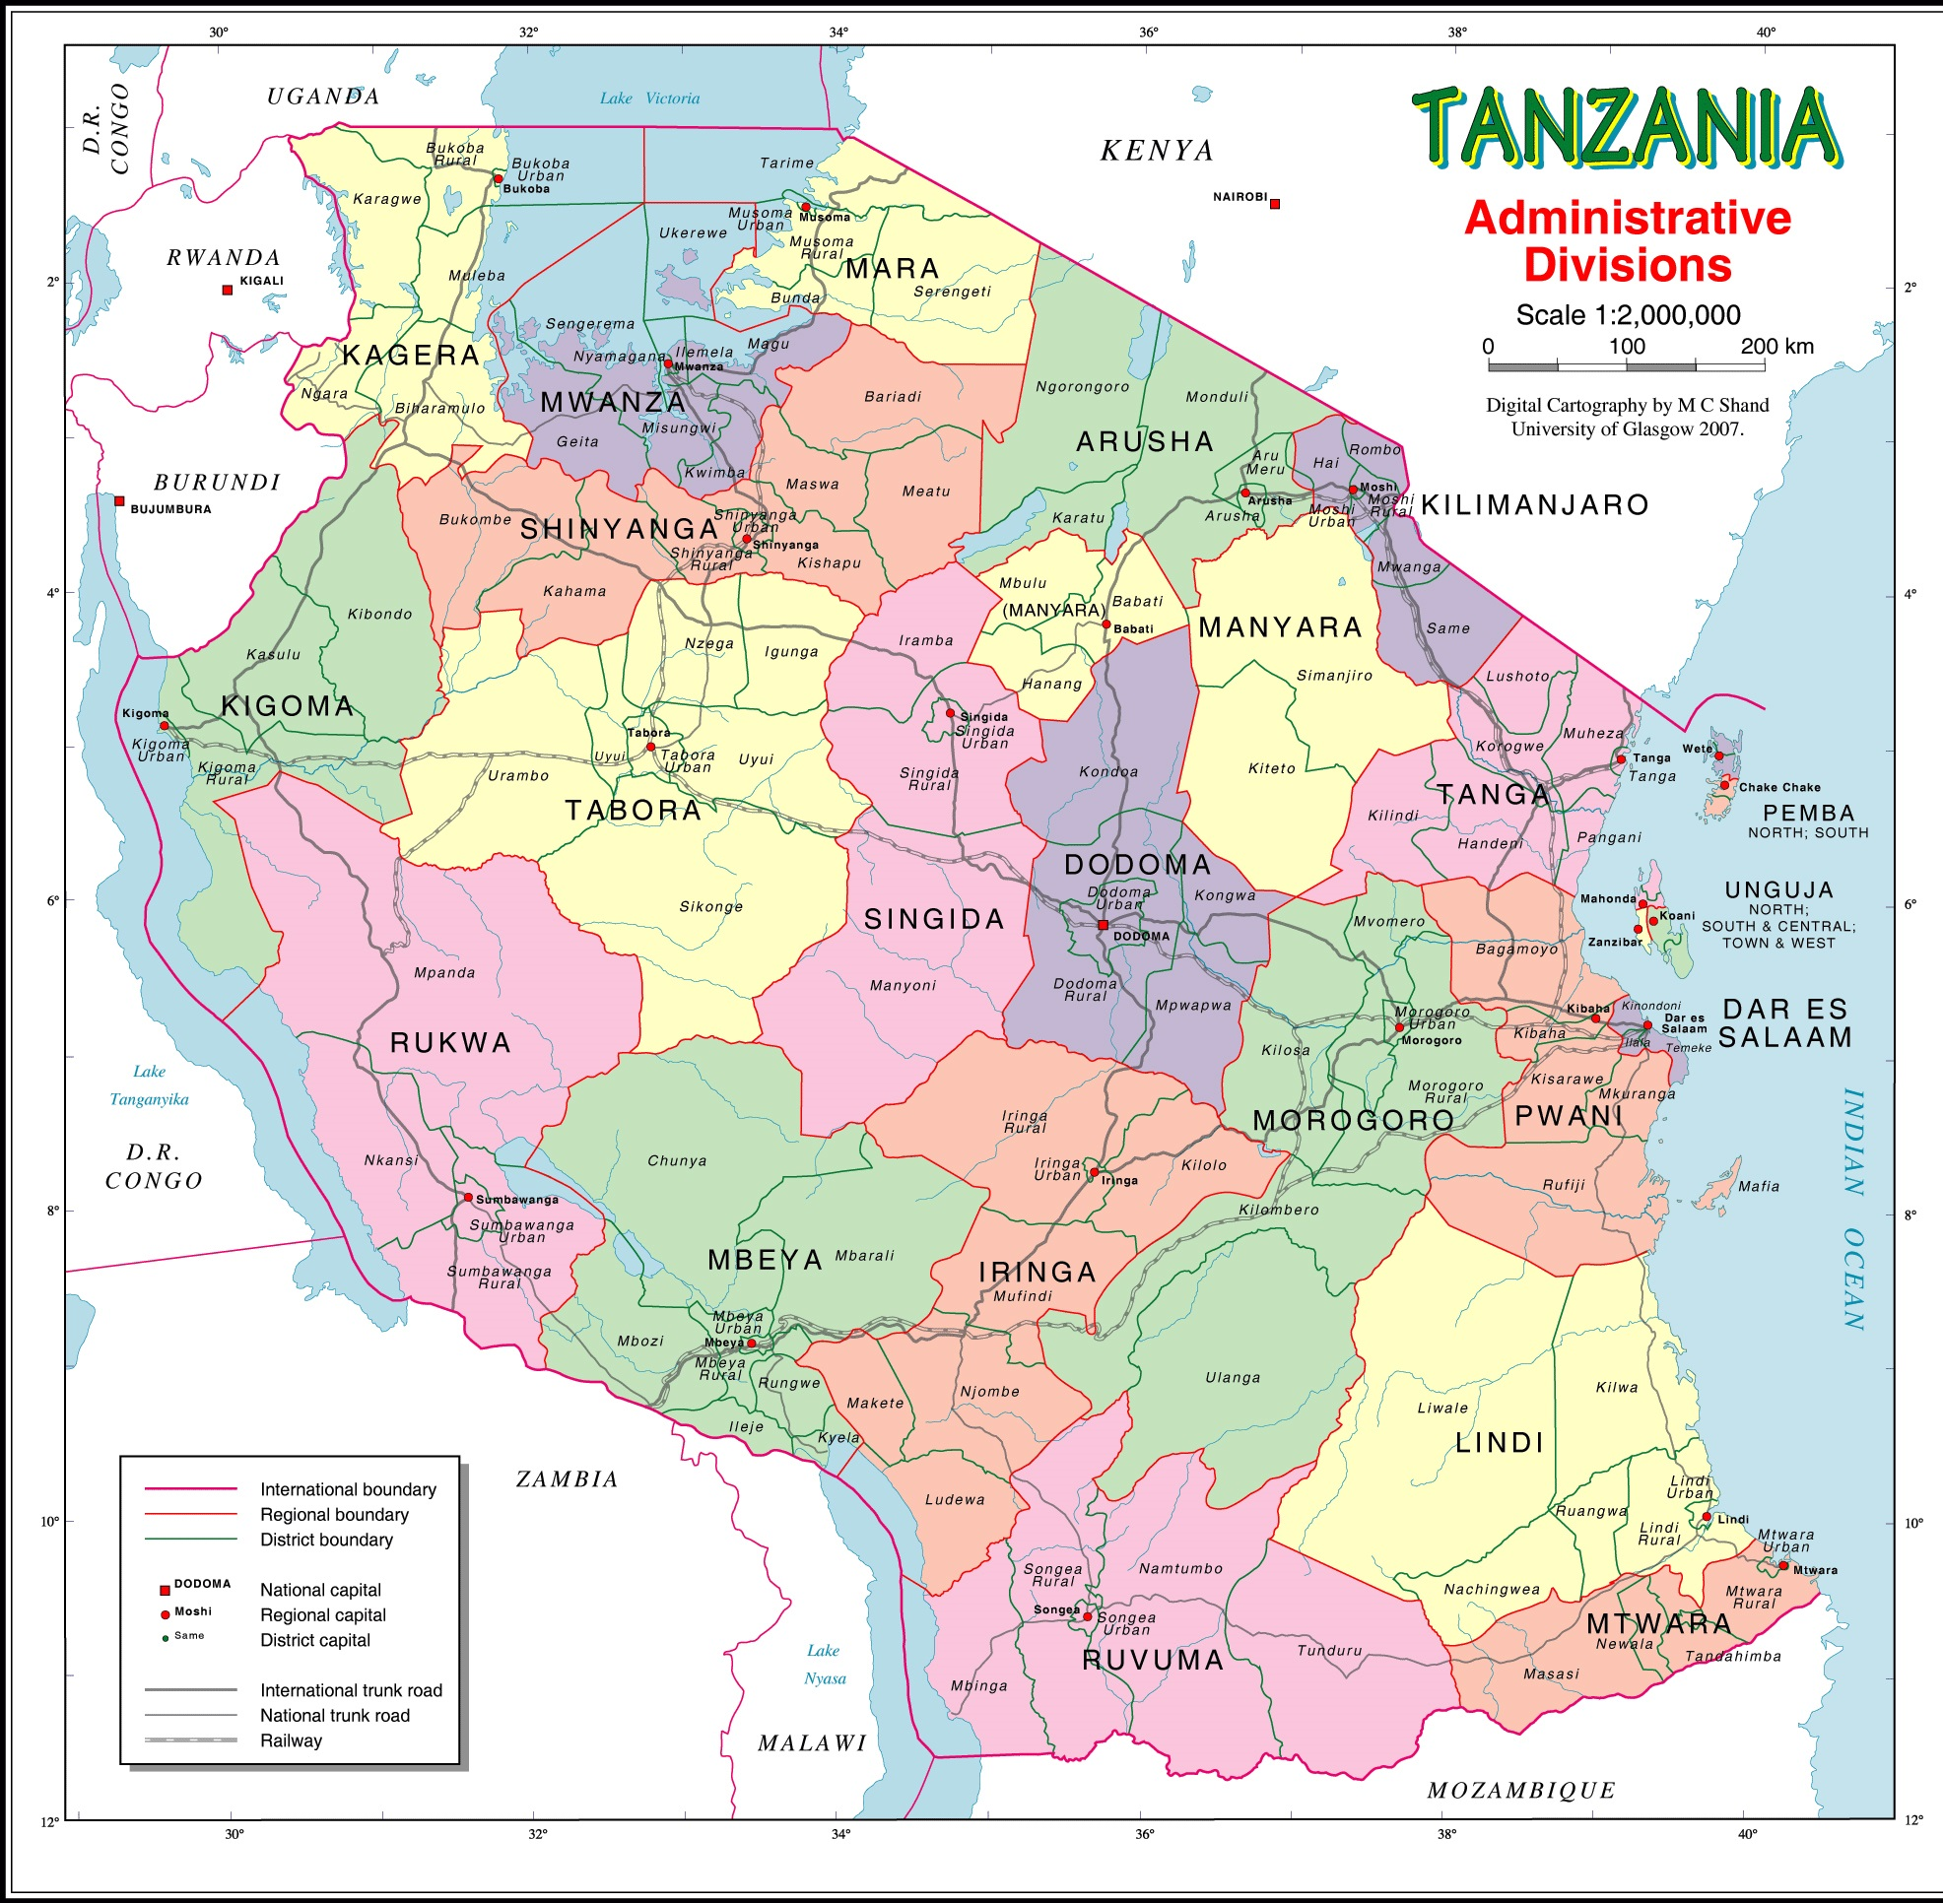
A study visit on hospital management (5’S KAIZEN TQM) in Tanzania
a
Dr. Md. Emdadul Haque
Senior consultant (Gyn & Obst),
Jhenaidah Sadar Hospital

Slide 2
Objectives
A GoB and JICA team visited Tanzania from 13-19 September 2015
Objectives:
  To understand the health system management;
  To observe 5S-Kaizen-TQM activities and quality of maternal and neonatal care services;
  Collect necessary materials related to systematic Kaizen training; and
  Develop action plan for implementation of systematic Kaizen in Bangladesh

Slide 3
Places/hospitals visited
JICA-Tanzania office and the project office
Ministry of Health Social Welfare (MOHSW)
Department of Health Quality Assurance, MOHSW
Mbeya Regional Hospital
Muhimbili National Hospital

Slide 4
Country Profile: Tanzania
Area: | 947,000 sq km
Population: | 45 million (2012); 70% rural
Population density: | Ave. 51 per sq km.
Literacy rate: | 68% for 15 years and above
Per capita GDP: | $998
CPR: | 34.4%
TFR: | 4.95 (2014)
MMR: | 460 per 100,000 live births (2010)
IMR: | 44 per 1000 live births (2014)
NMR: | 21 per 1000 live births (2015)

Slide 5
Hospital services management
Public hospitals provides free services to:
  Pregnant and post-partum women
  Under 5 Children
  Population aged >65 years
  Women with chronic diseases
  Poor
20% population is covered by health insurance
Majority use public hospitals for delivery (hospital delivery rate is 47%)
The salary of the heath stuffs is nearly 3 times than Bangladesh. Over duty salary is there.

Slide 6
Hospital services management
JICA supports quality improvement of hospital services through 5S-Kaizen-TQM along with other technical supports
There is separate dept. for Health Quality Assurance under the MOHSW
  The main functions are to take quality initiatives (introduction of 5S-Kaizen-TQM, IP&C, hospital safety etc.) and supportive supervision

Slide 7
Hospital services management
5S-Kaizen-TQM:
  Introduced in 2007
  67 hospitals practice the methodology
  Some private hospitals introduced 5S through Private Hospital Association
  MOH provides supportive supervision to both public and private hospitals through regional teams
  5S has been included in the nurses’ curriculum

Slide 8
Observations/ Learning
Hospitals are supported by Facility Governance Committee
The committee makes annual hospital plan and submit to MOH for approval
Health system is decentralized.
Has very strong referral system

Slide 9
Mbeya Regional Hospital
Mbeya Regional Hospital is a referral hospital with 477 beds having 70 doctors, 250 nurses and 300 medical attendants.
Maternity services (150 beds) provided from a separate campus
5S-Kaizen-TQM was introduced in 2007
This hospital is the learning site for other hospitals in Tanzania as well as for regional countries
Bed occupancy rate is 70% (in general) [80% for maternity hospital]
600 patients are seen in the OPD daily
QIT consists of 15 members, while WITs are present in all the 57 sections
There is substantial improvement of hospital services after implementation of 5S
  Hospital becomes patient friendly
  Clean environment
  All staff are involved in the process
  Patient satisfaction has improved

Slide 10
Mbeya Regional Hospital
5S and Kaizen is practiced in all the sections, all the files were labeled and arranged
Cleanliness was remarkable
Zoning of equipments, furniture and beds were done
Regular monitoring of 5S activities are done and findings are displayed on the boards
Documentation of Kaizen activities was very good (maintained Kaizen files and posters)
The hospital has central supply system including the sterilization of equipments
The wards were found to be very clean including well managed drug trolley
Visitors are strictly controlled
All the clinical files (for patients) are computerized

Slide 11
Mbeya Maternity Hospital
150 bedded hospital run by 5 specialist, 5 MOs and 60 Nurses
Coverage for any ANC is very high (90%) though coverage for 4+ ANC is low
500 deliveries are conducted in a month
Common pregnancy complications treated are: Eclampsia and Pre-eclampsia, pregnancy hypertension, sepsis, PPH, and unsafe abortion
C-section rate: 35-40%
Anesthesia is given by Nurses trained for 2 years
Has 7 delivery rooms, very clean with privacy and uses separate sets for each patients
Maternal and neonatal ICU is there for critical patients
Reflection of 5S-Kaizen is visible everywhere

Slide 12
Muhimbili National Hospital
1,000 bedded tertiary teaching hospital (autonomous)
Run by 400 Doctors (mostly specialists), 1,200 Nurses and 400 Medical attendants
Bed occupancy rate: 100% (varies from dept. to dept.)
About 900 deliveries conducted per month
60% of the patients receive free treatment
Has separate Quality Improvement Unit, supported by a Quality Manager and 12 staff
Practices 5S and Kaizen
WITs organize on-the-job training every week

Slide 13
5S-Kaizen-TQM
Has a 25-member National 5S-Kaizen Facilitation Team consists of Govt. staff and staff from other organizations
Facilitation team is responsible for:
  Training facilitation
  Supportive supervision and monitoring
  Develop training materials and guideline
5S is discussed in the morning session in all hospitals

Slide 14
Recommendations
Develop National 5S-Kaizen Facilitation Team
Introduce systematic Kaizen at some of the hospitals through regular training
Nurses are the center of 5S/Kaizen activity. Empowerment of nurses is required to make 5S/Kaizen successful
Establish one or two model 5S-Kaizen hospitals in Bangladesh

Slide 15
Future Plan
  Sharing experience of Tanzania visit among the Sadar Hospital stuffs of Jhenaidah
  Introduction of systematic Kaizen at the OBST department of Jhenaidah District Hospital.
  Introduction of 5S at all (5) the UHCs of Jhenaidah District
  Initiate community participation at all UHCs

Slide 16
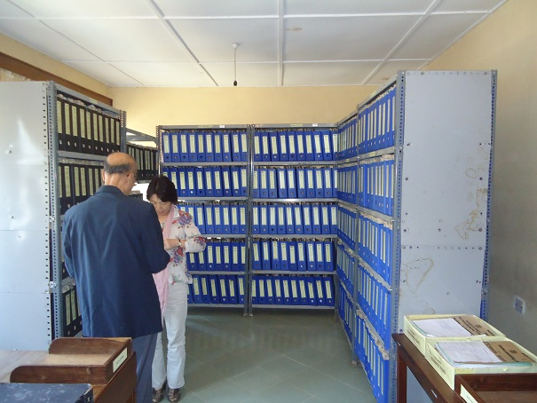
Hospitals in Tanzania

Slide 17
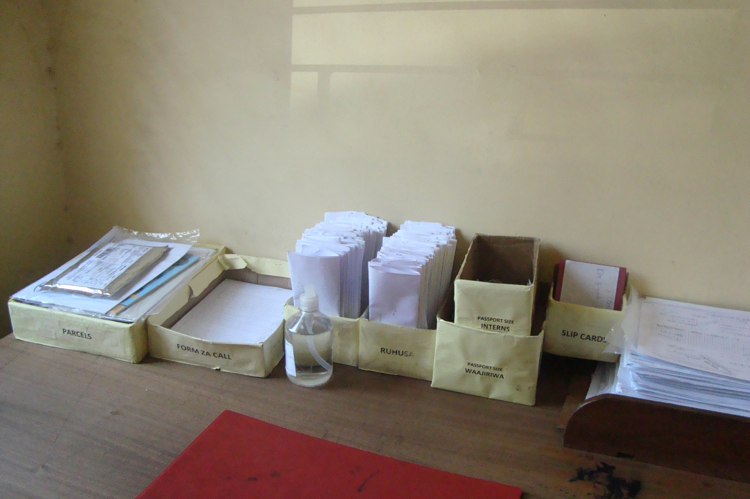
Hospitals in Tanzania

Slide 18
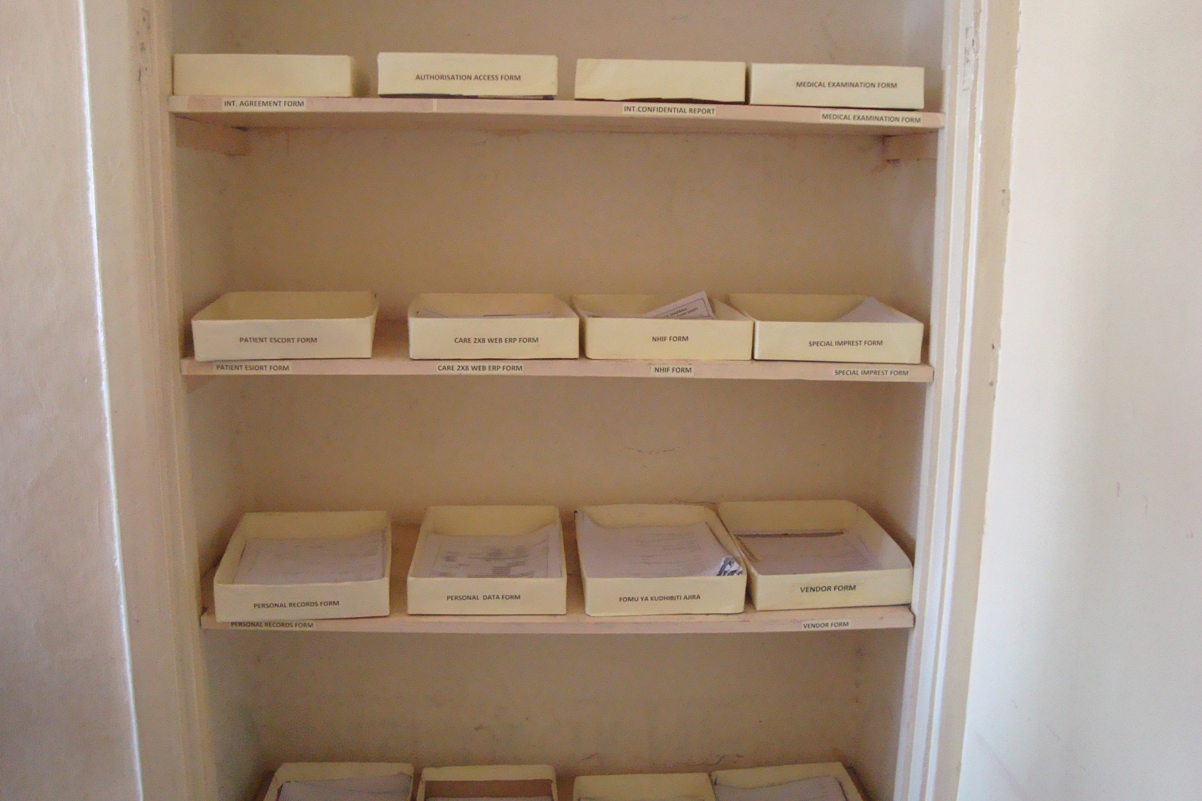
Hospitals in Tanzania

Slide 19
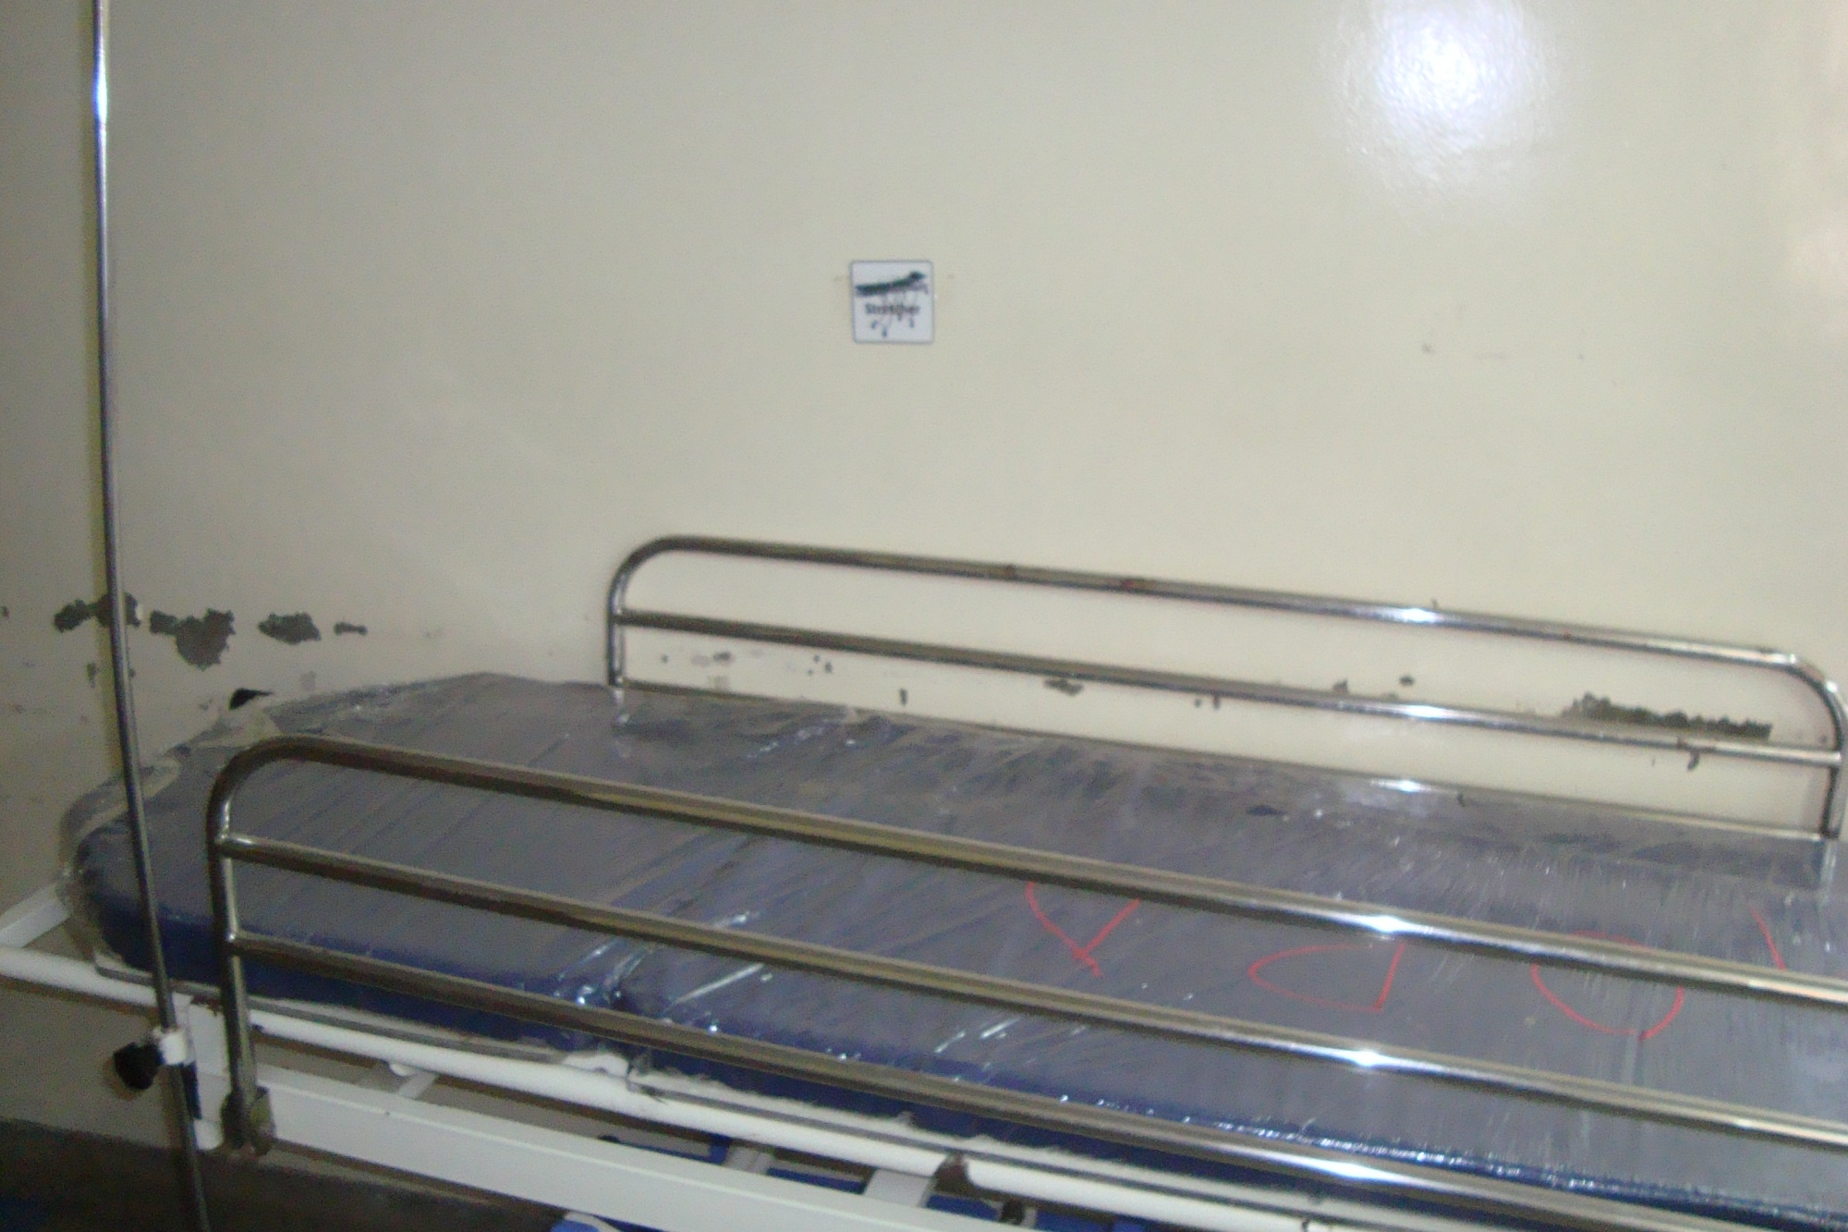
Hospitals in Tanzania

Slide 20
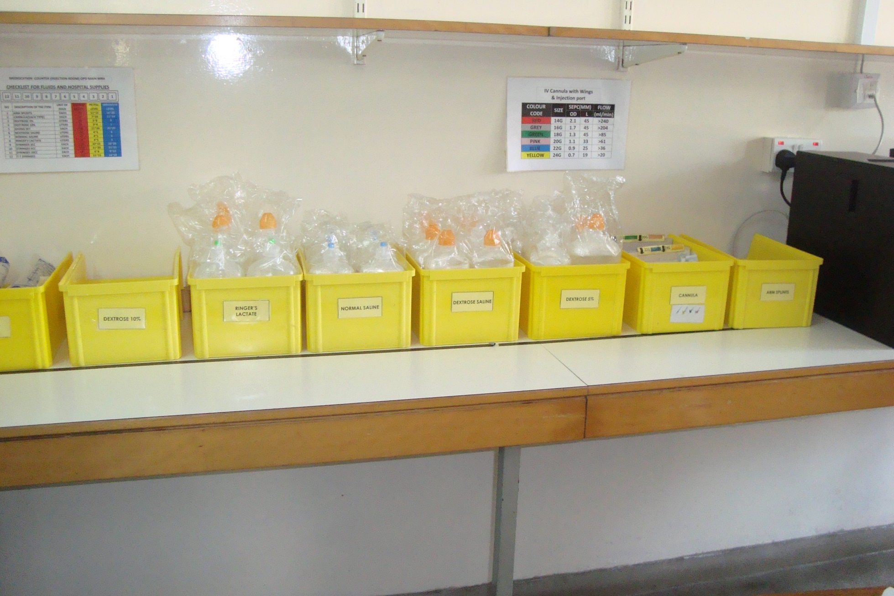
Hospitals in Tanzania

Slide 21
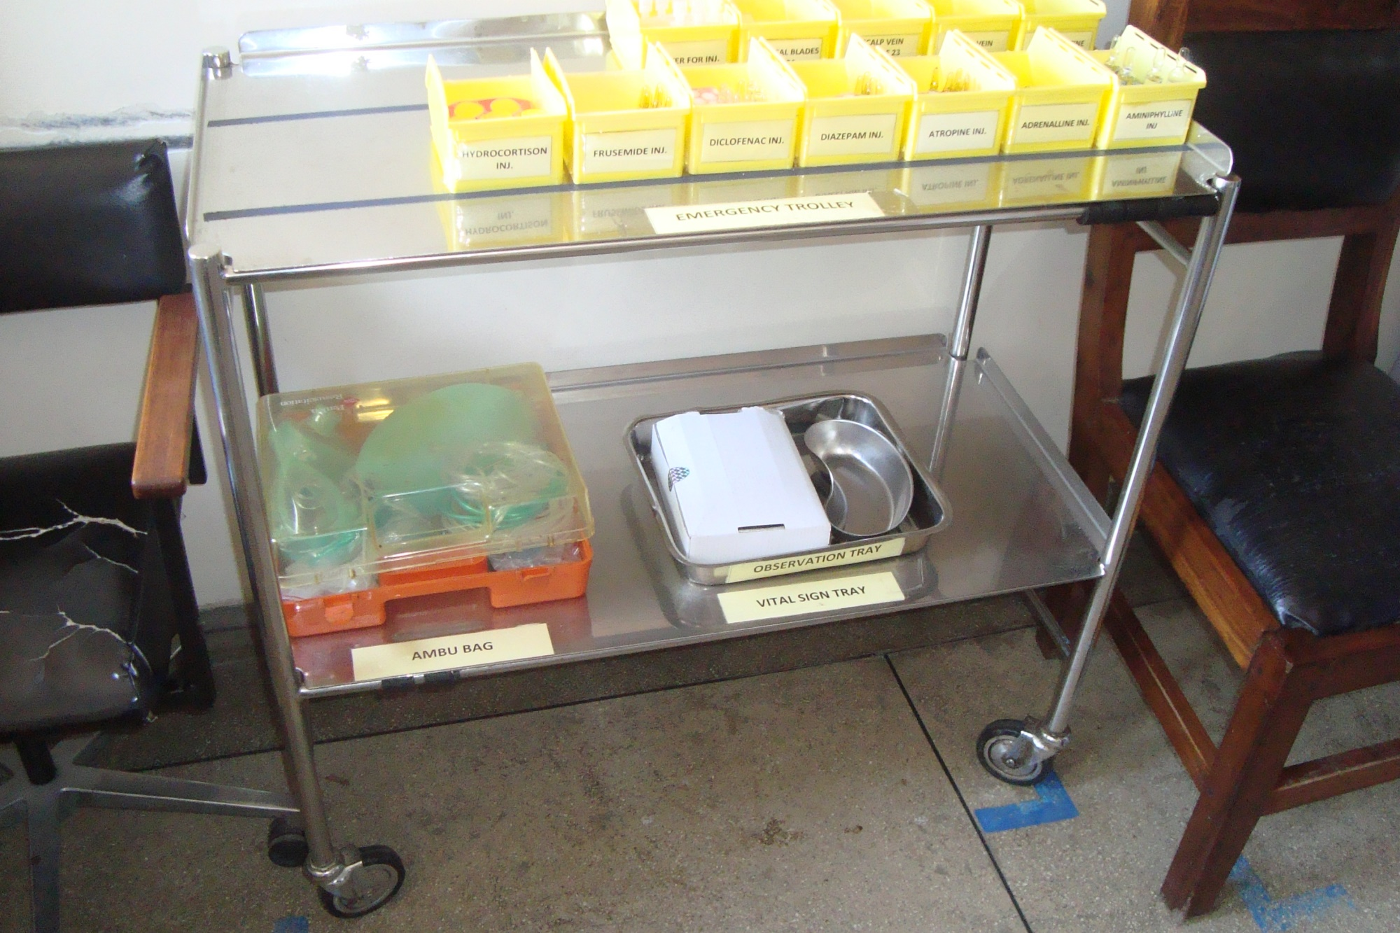
Hospitals in Tanzania

Slide 22
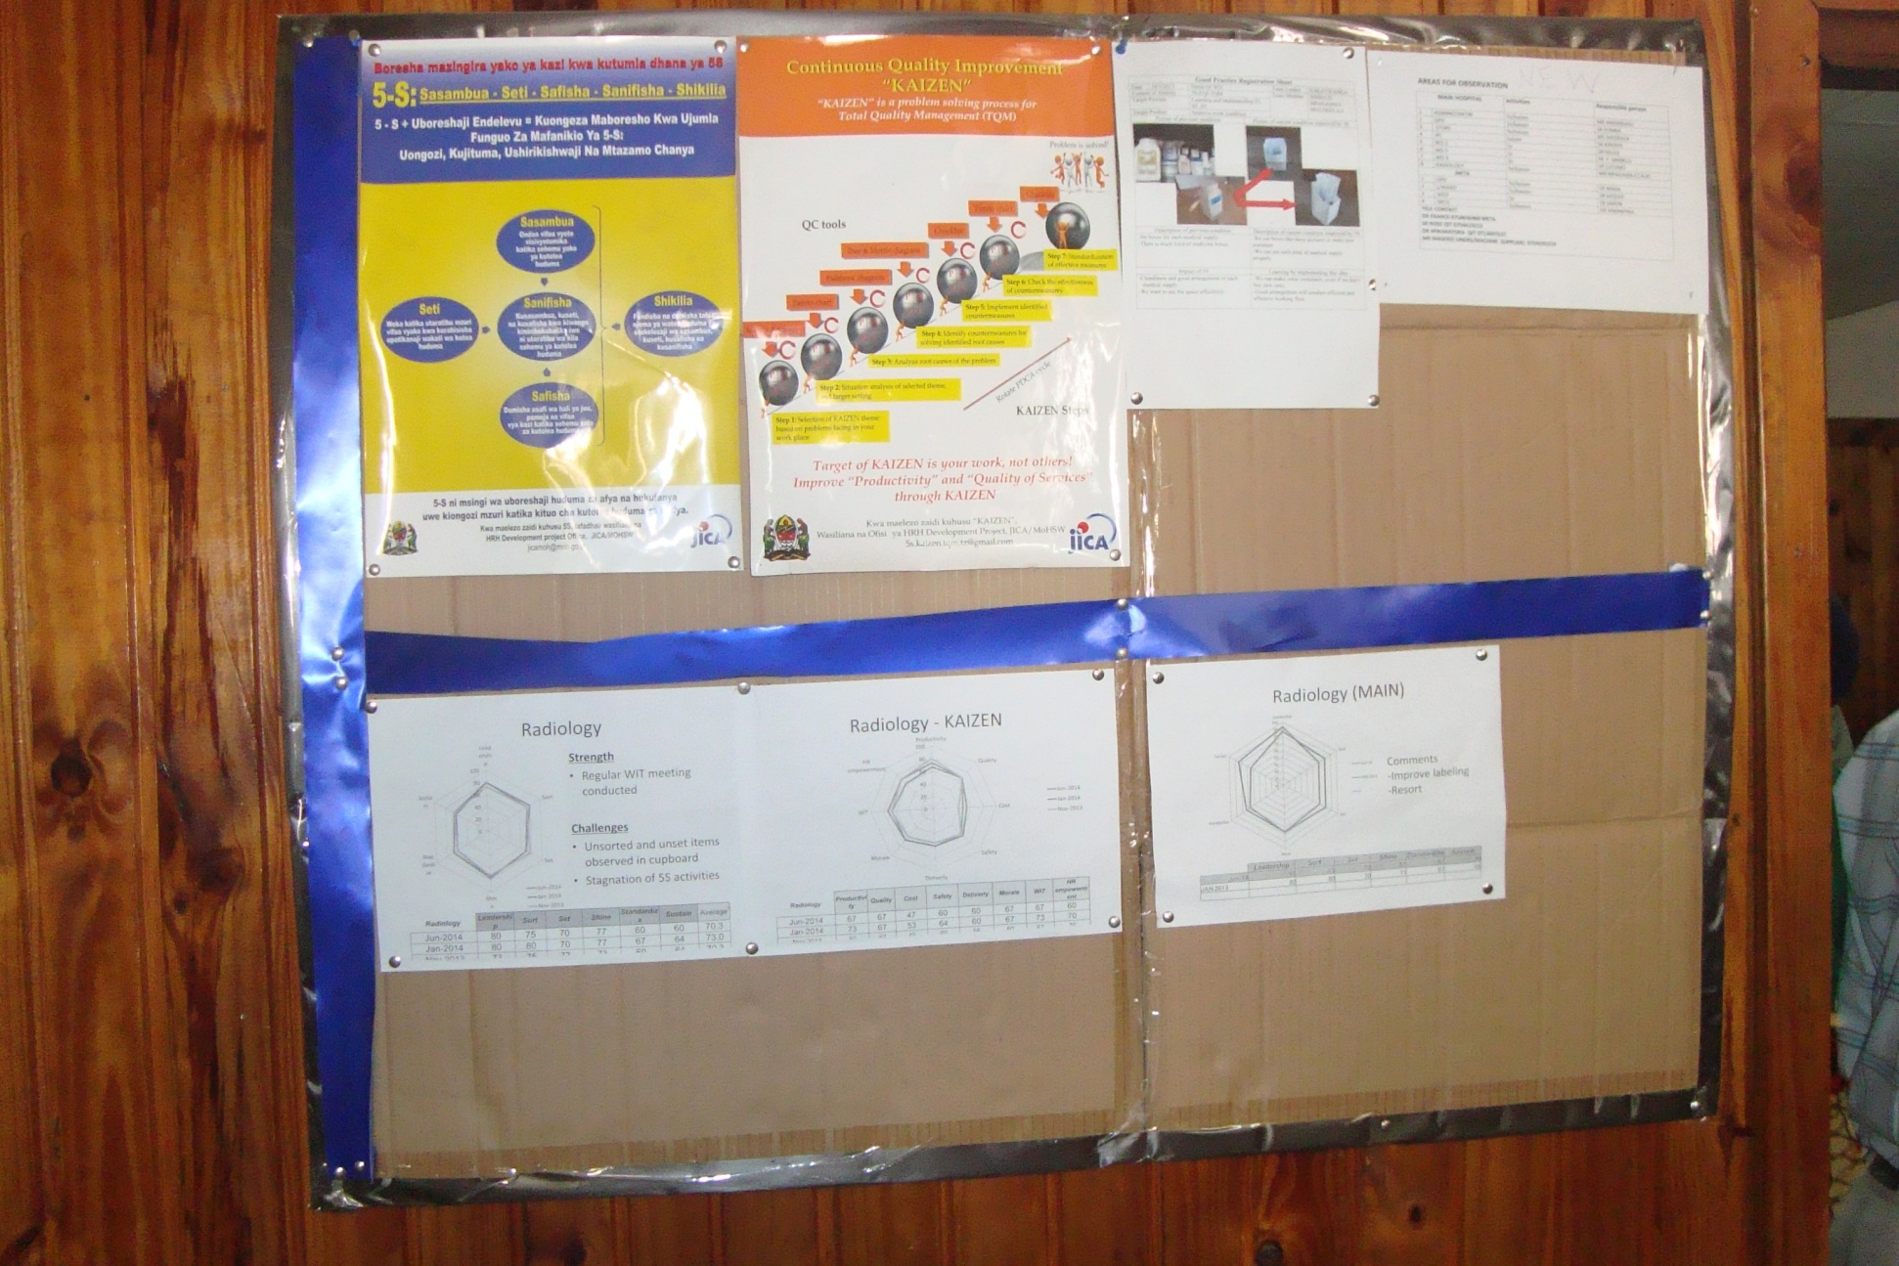
Hospitals in Tanzania

Slide 23
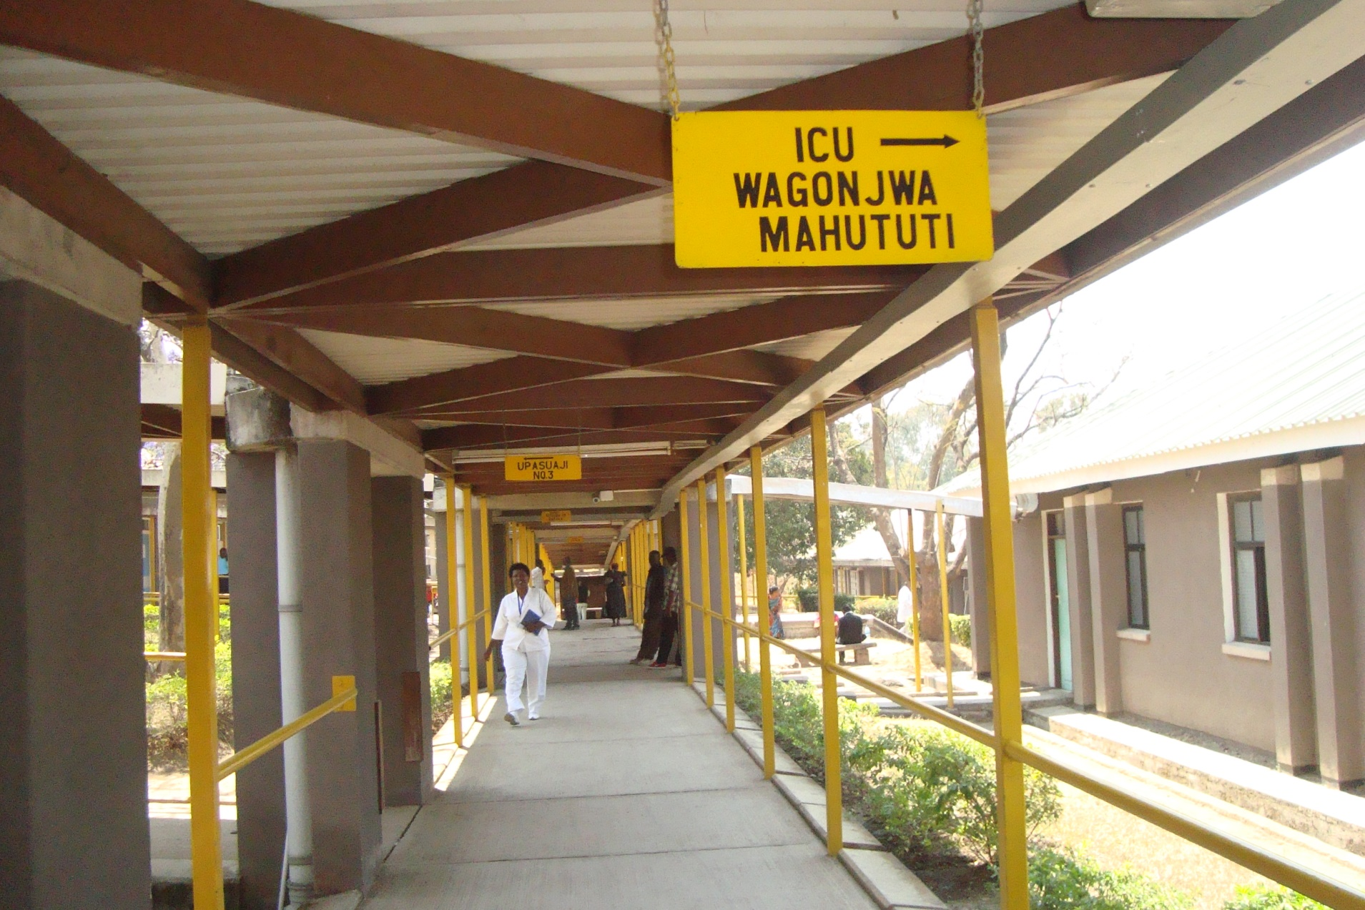
Hospitals in Tanzania

Slide 24
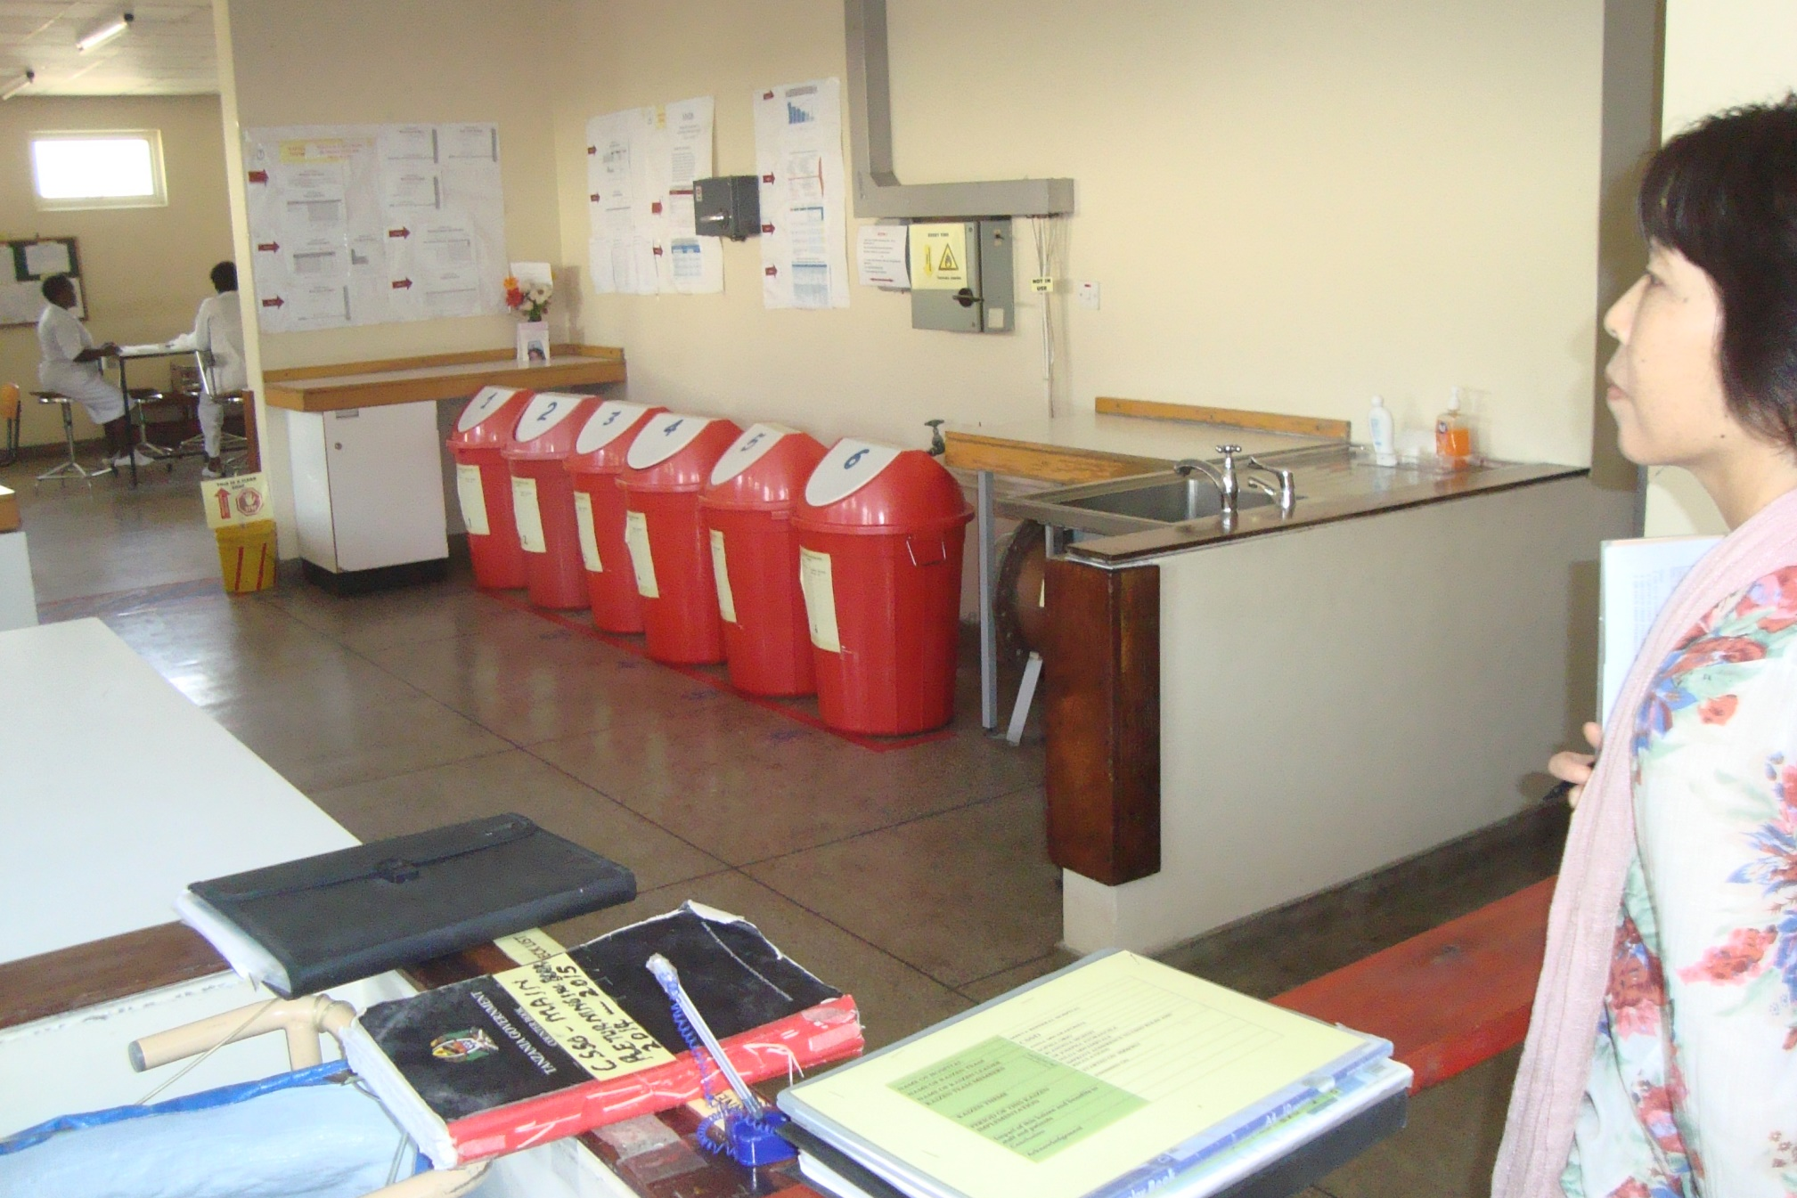
Hospitals in Tanzania

Slide 25
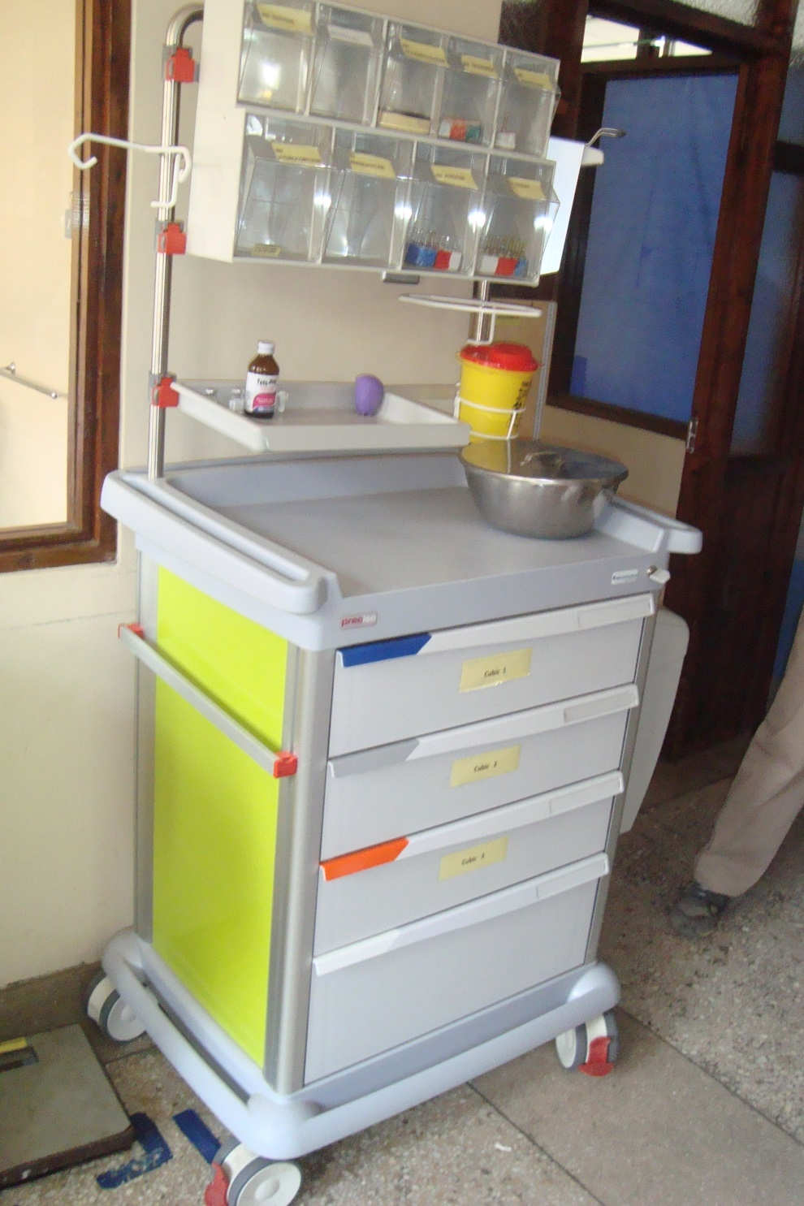
Hospitals in Tanzania

Slide 26
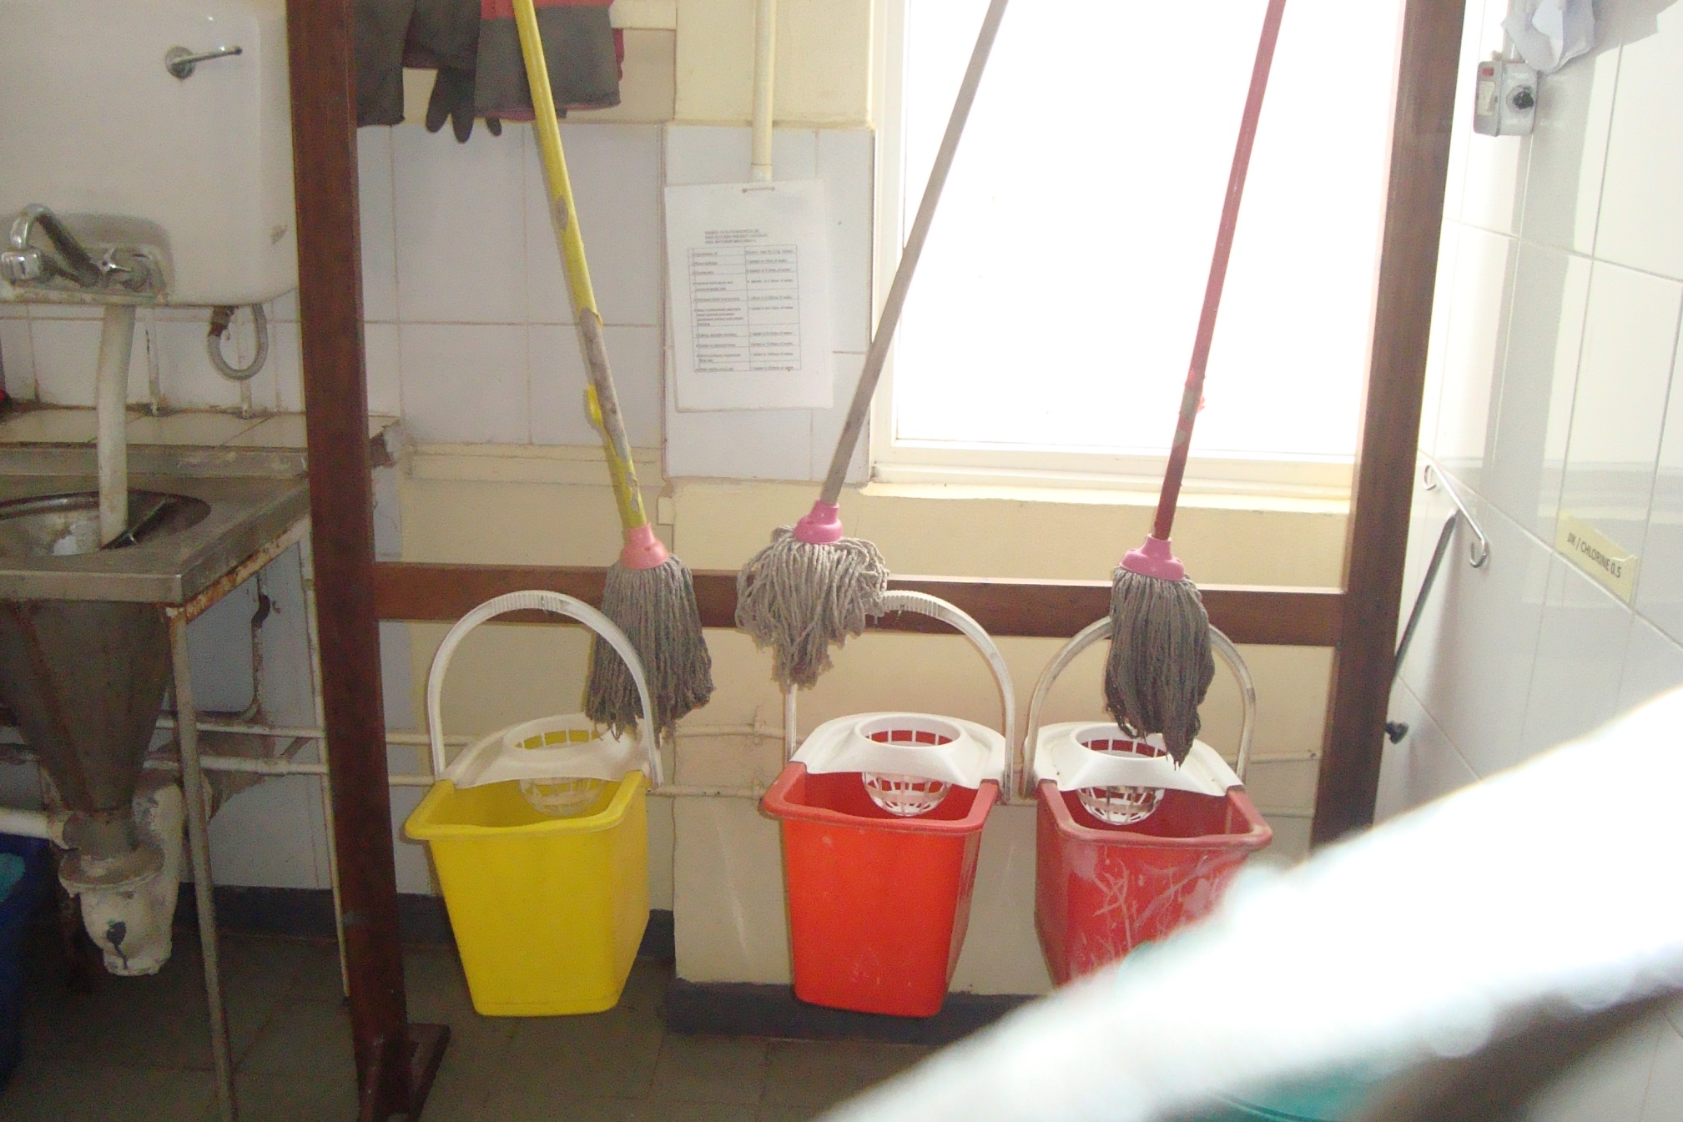
Hospitals in Tanzania

Slide 27
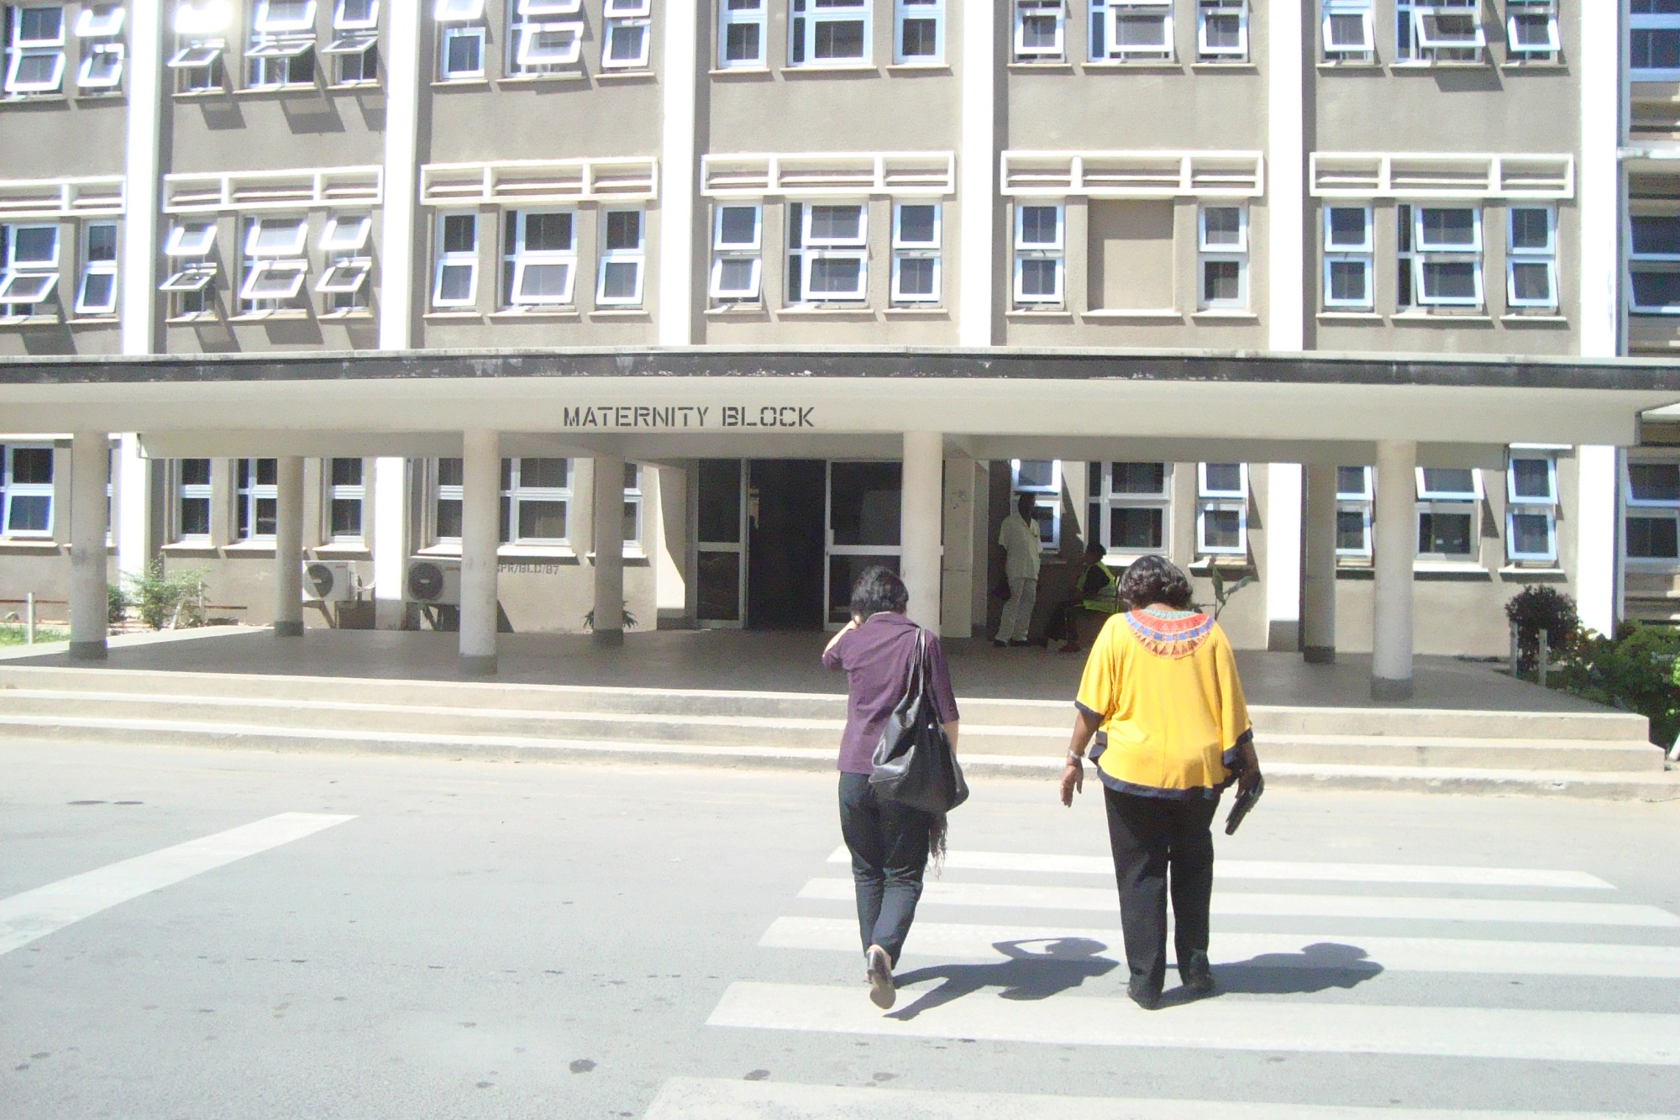
Hospitals in Tanzania

Slide 28
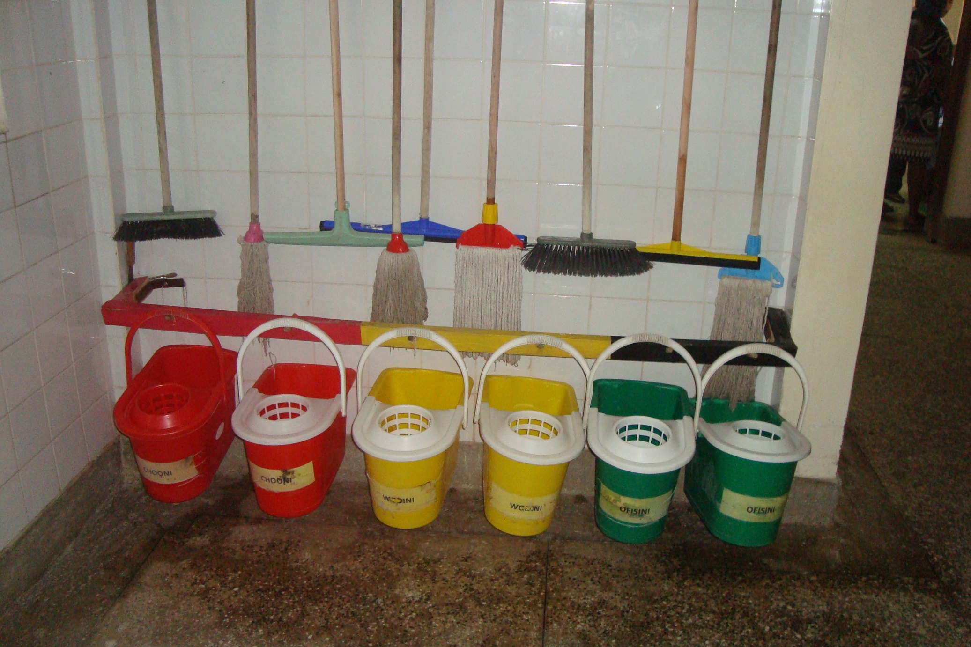
Hospitals in Tanzania

Slide 29
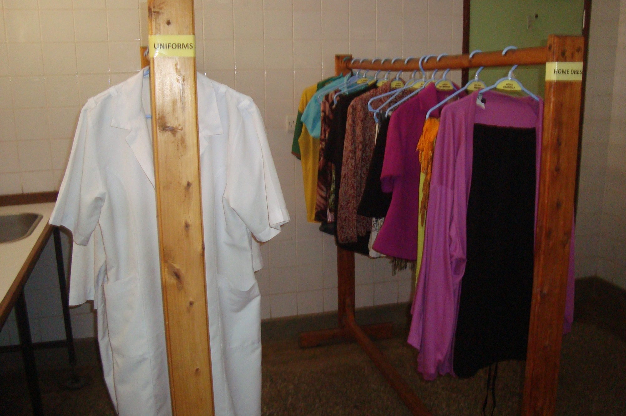
Hospitals in Tanzania

Slide 30
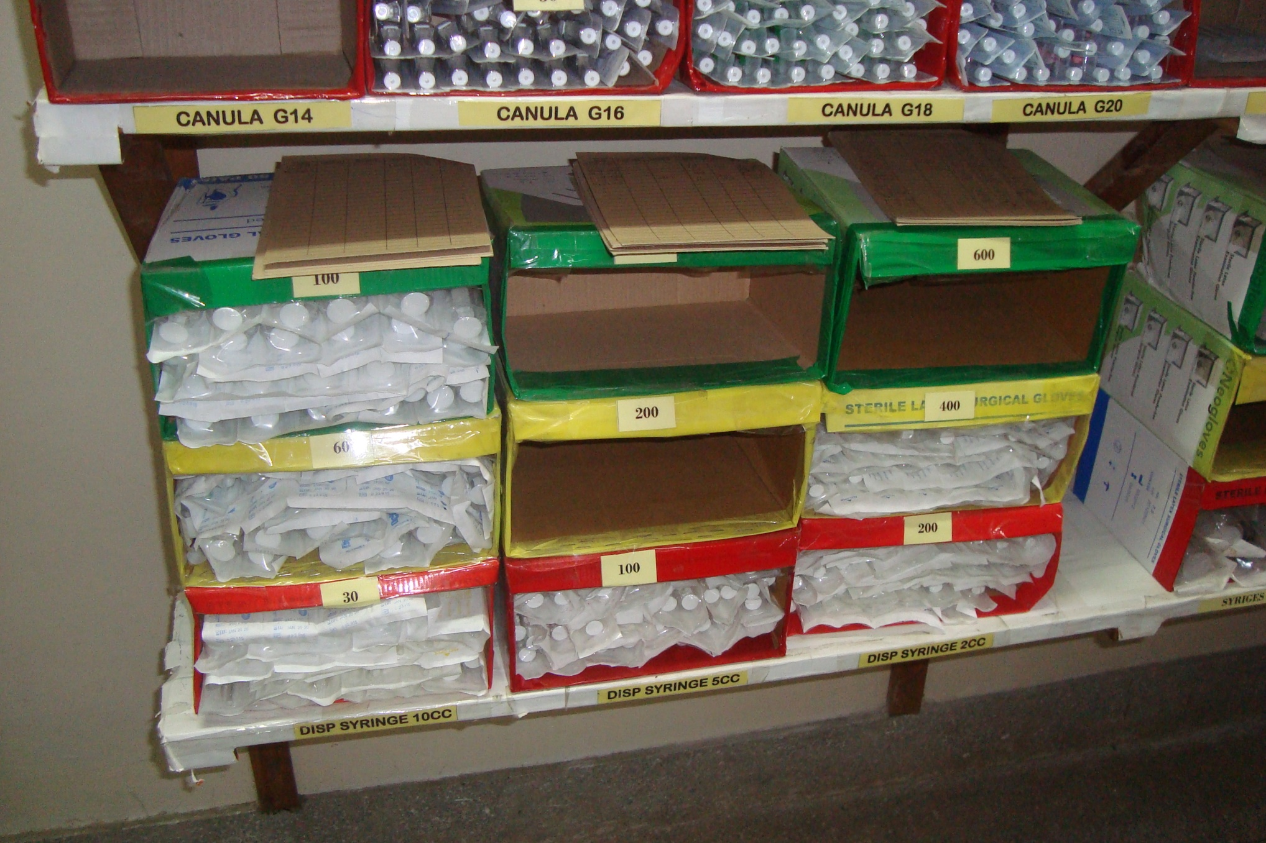
Hospitals in Tanzania

Slide 31
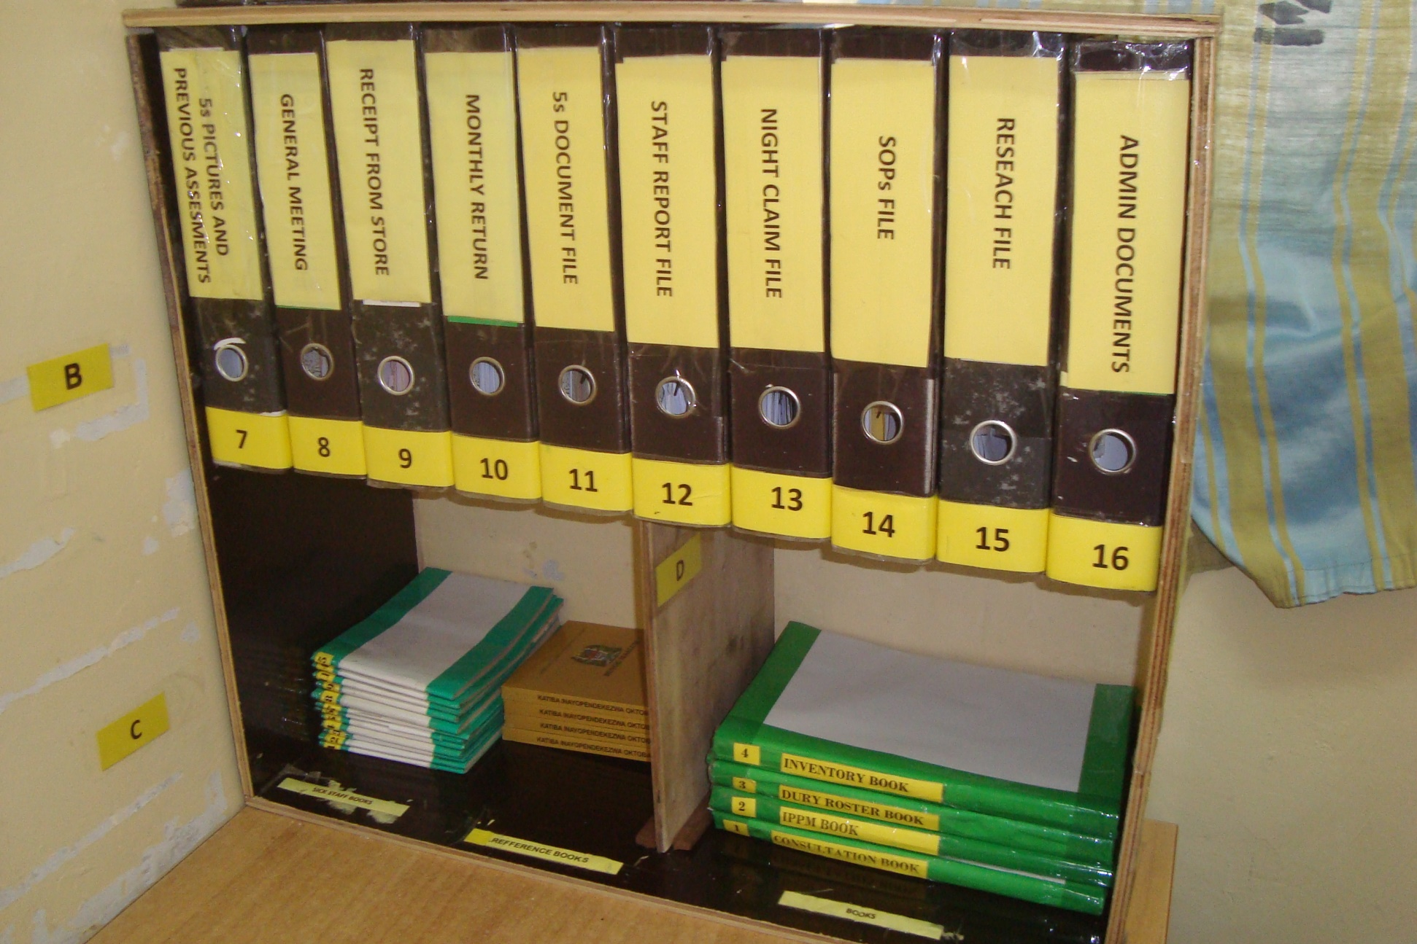
Hospitals in Tanzania

Slide 32
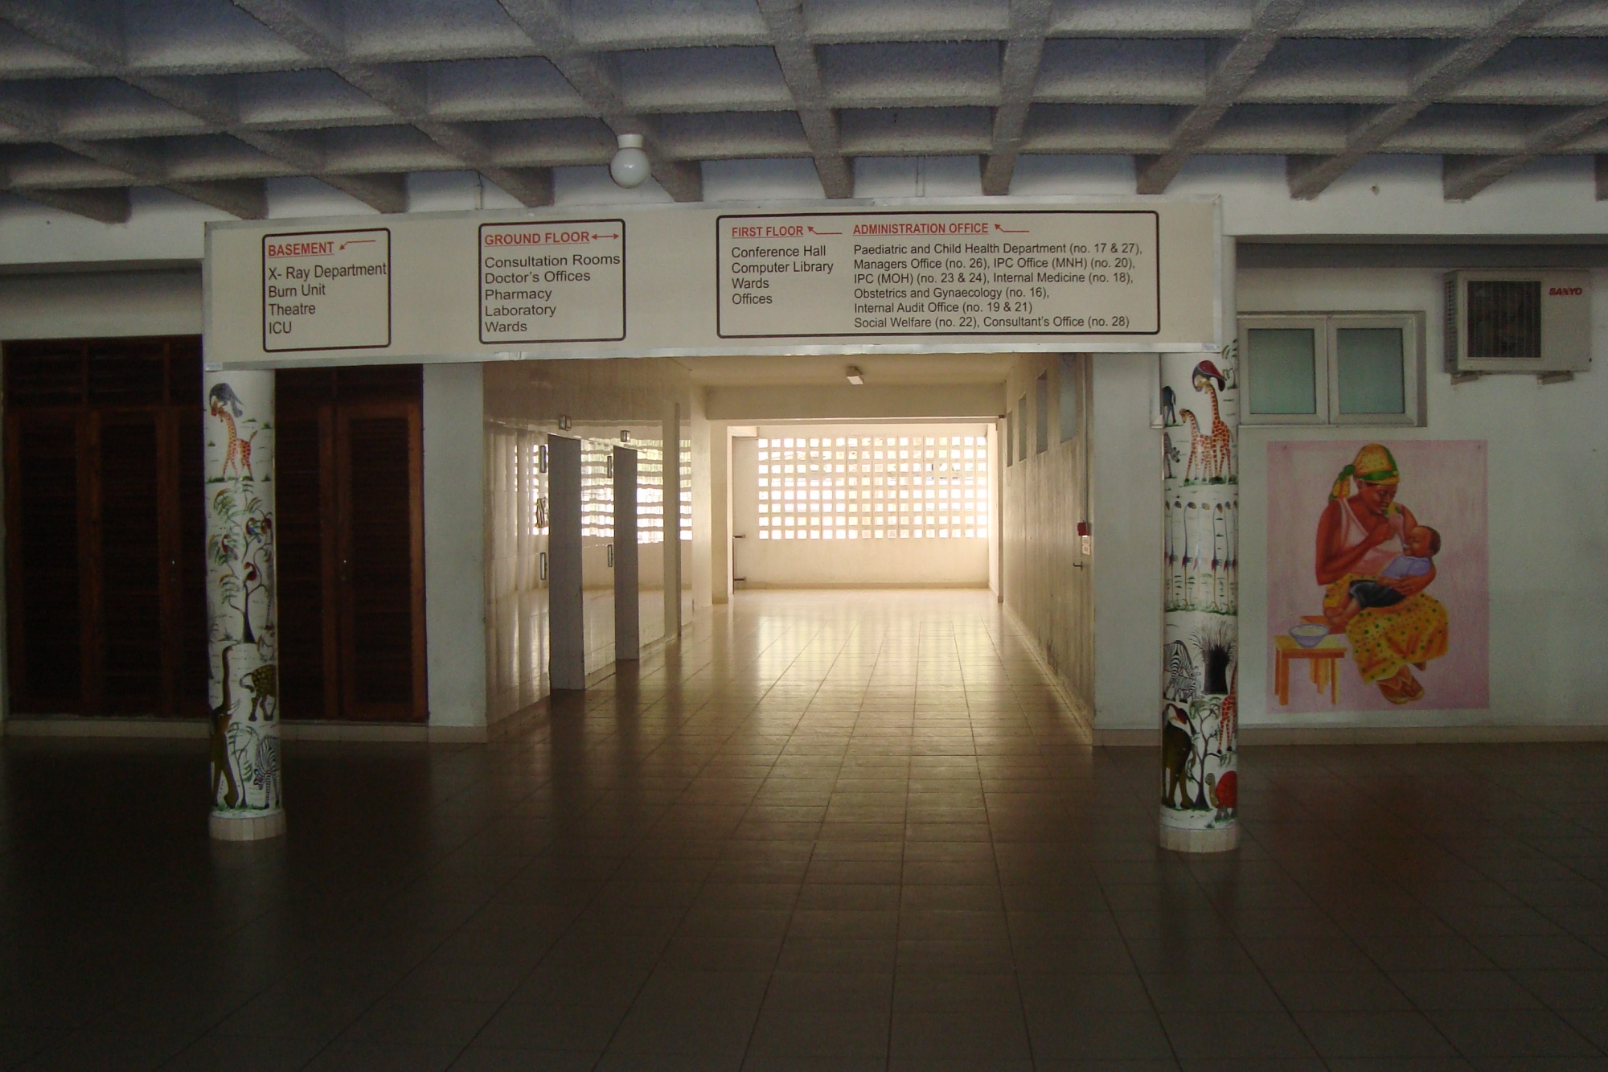
Hospitals in Tanzania

Slide 33
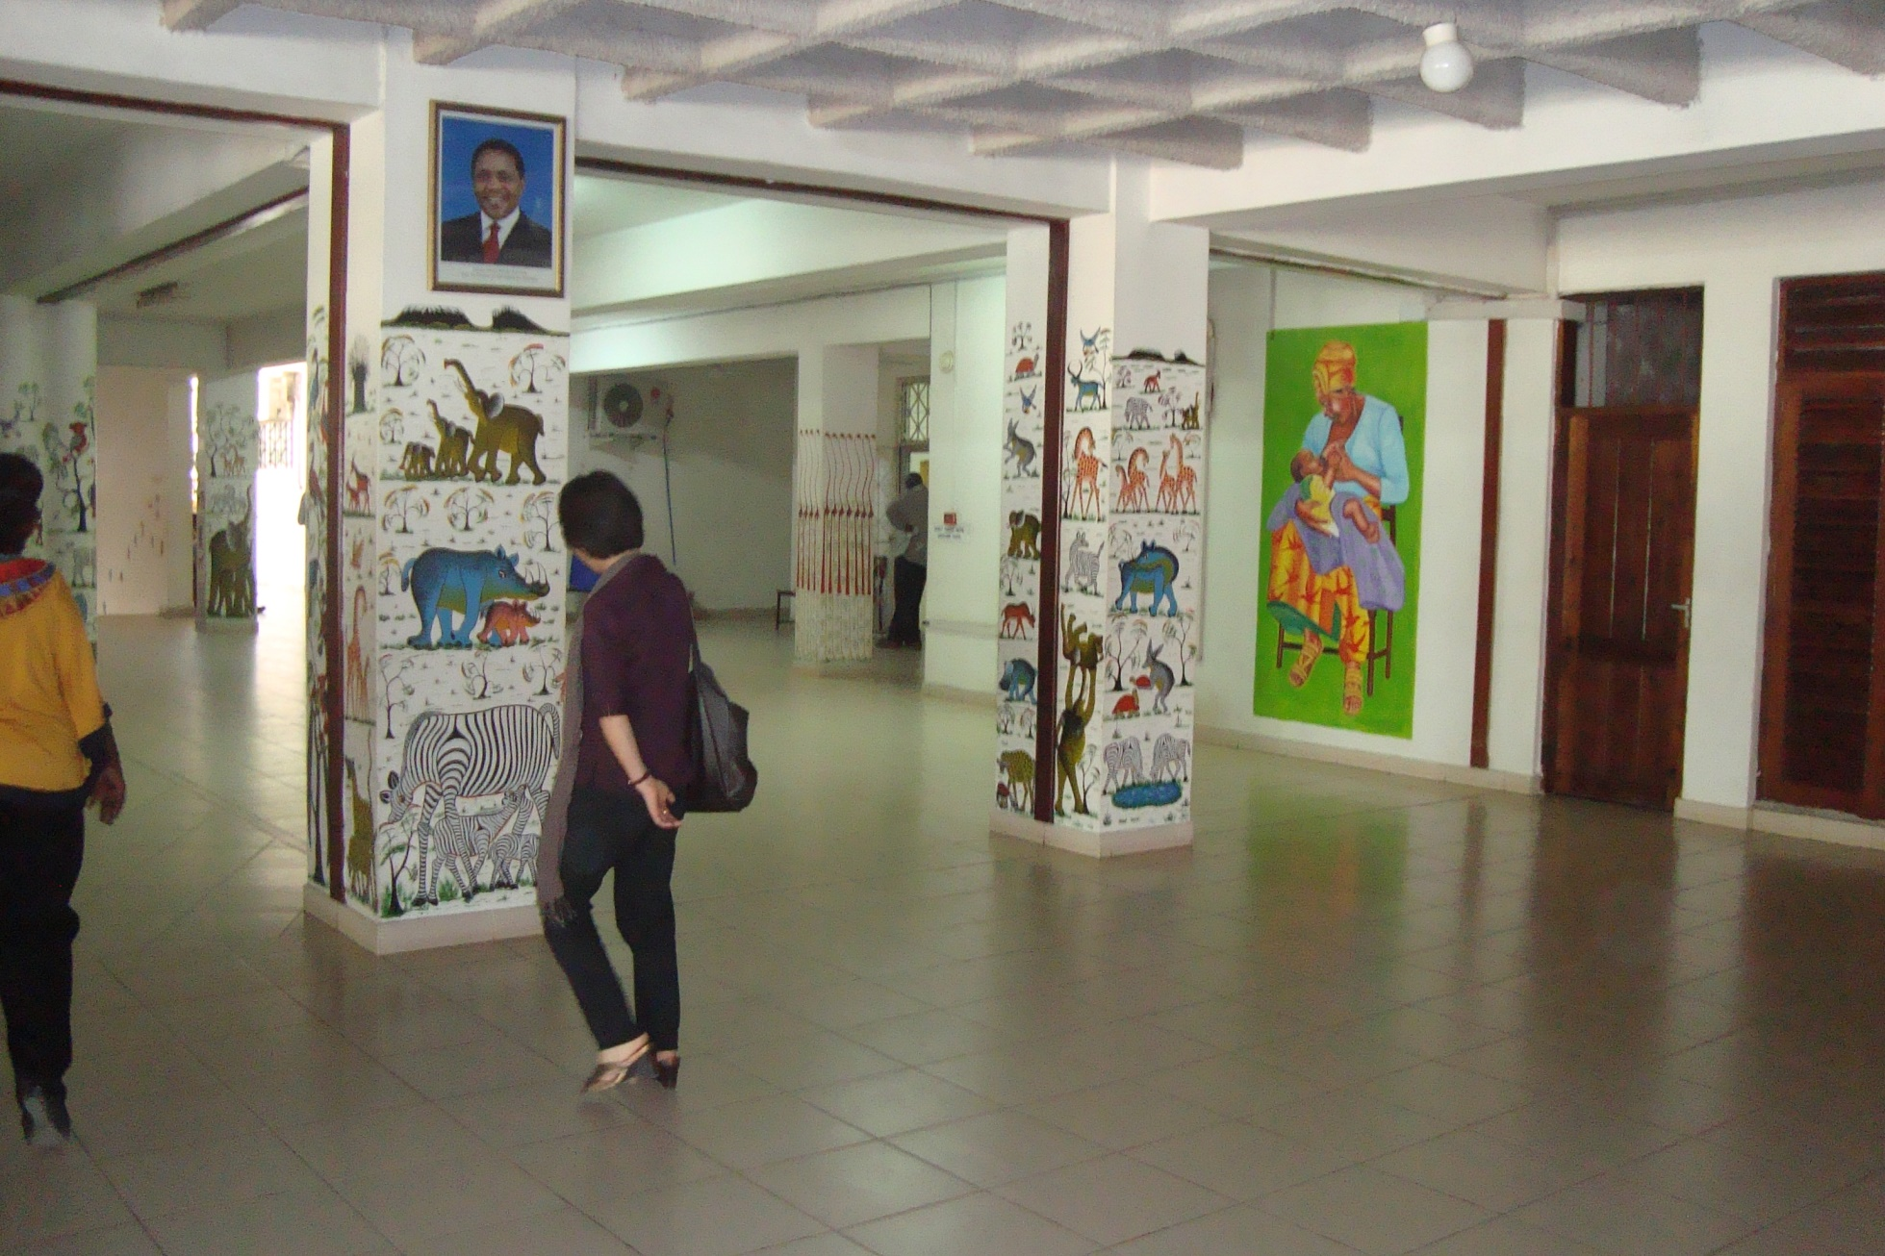
Hospitals in Tanzania

Slide 34
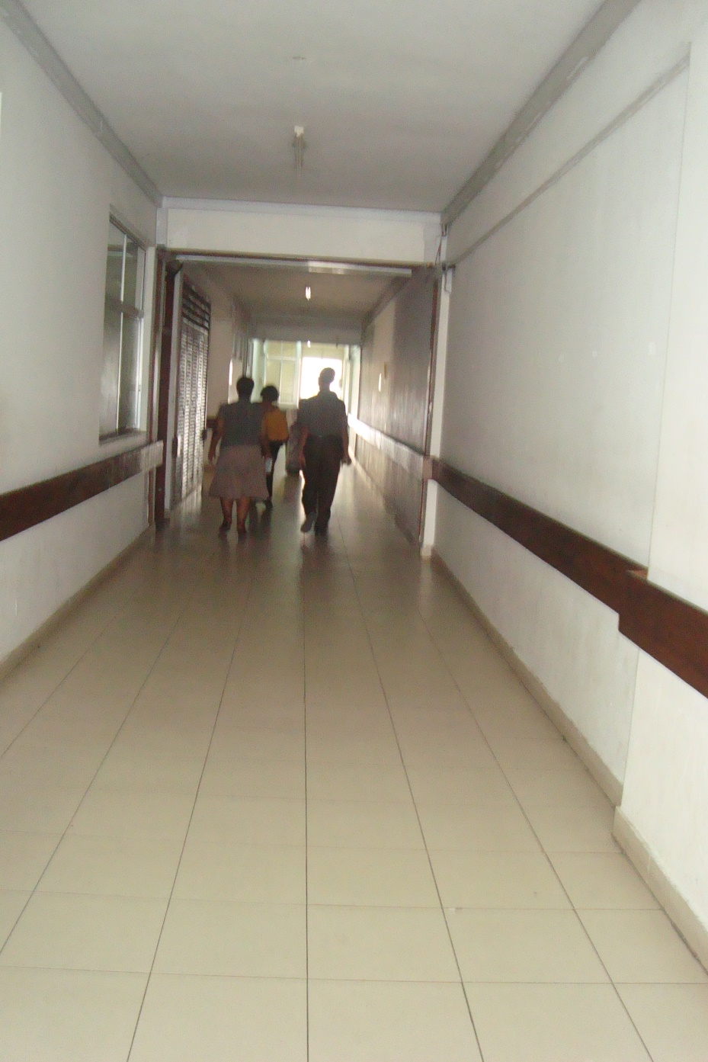
Hospitals in Tanzania

Slide 35
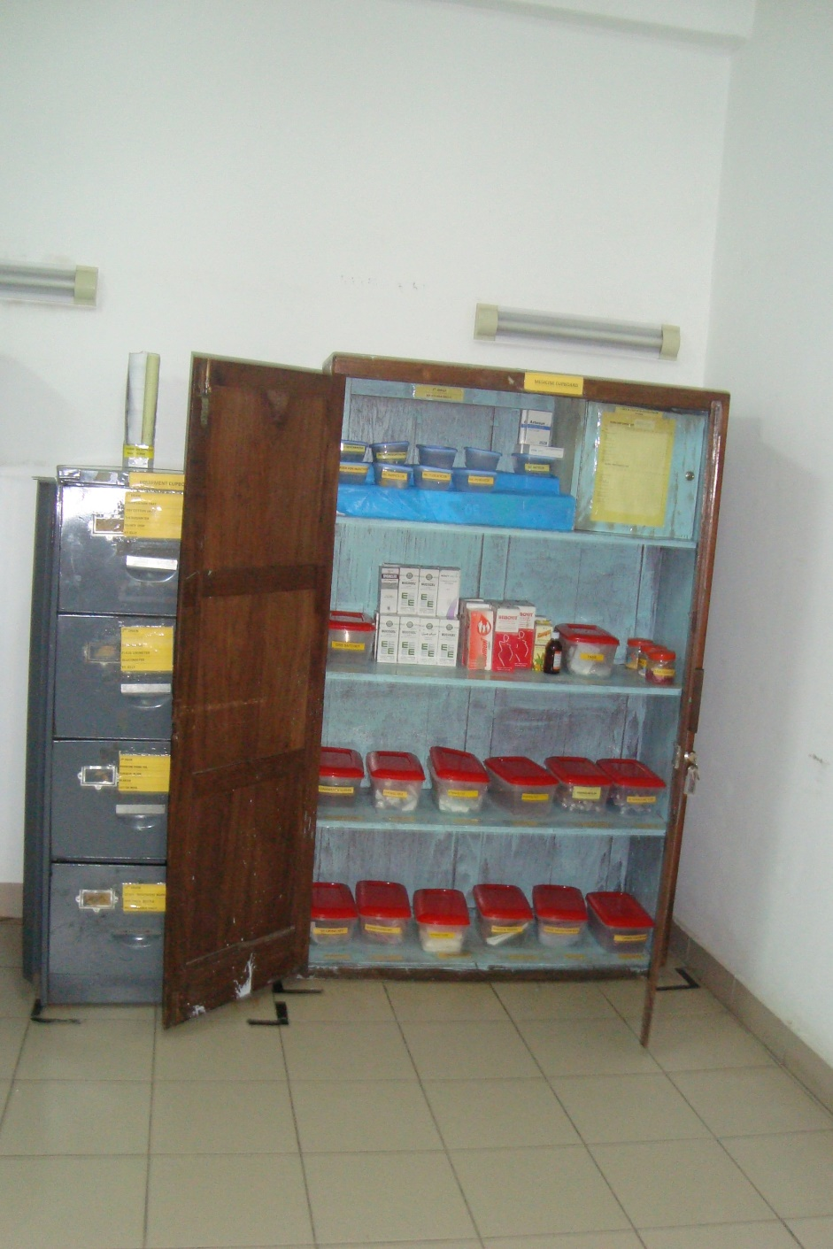
Hospitals in Tanzania

Slide 36
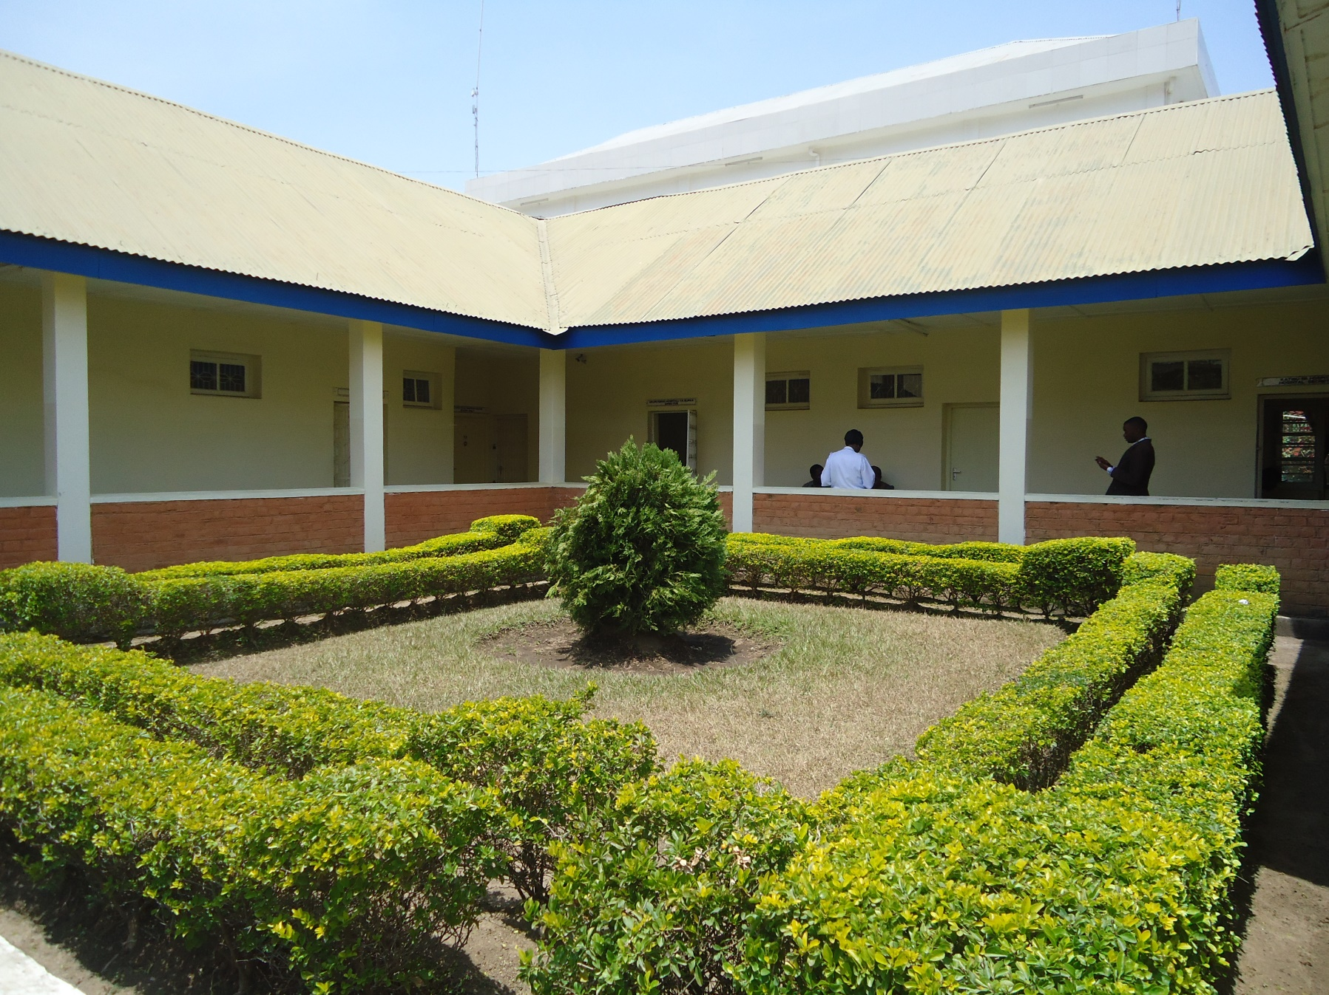
Hospitals in Tanzania

Slide 37
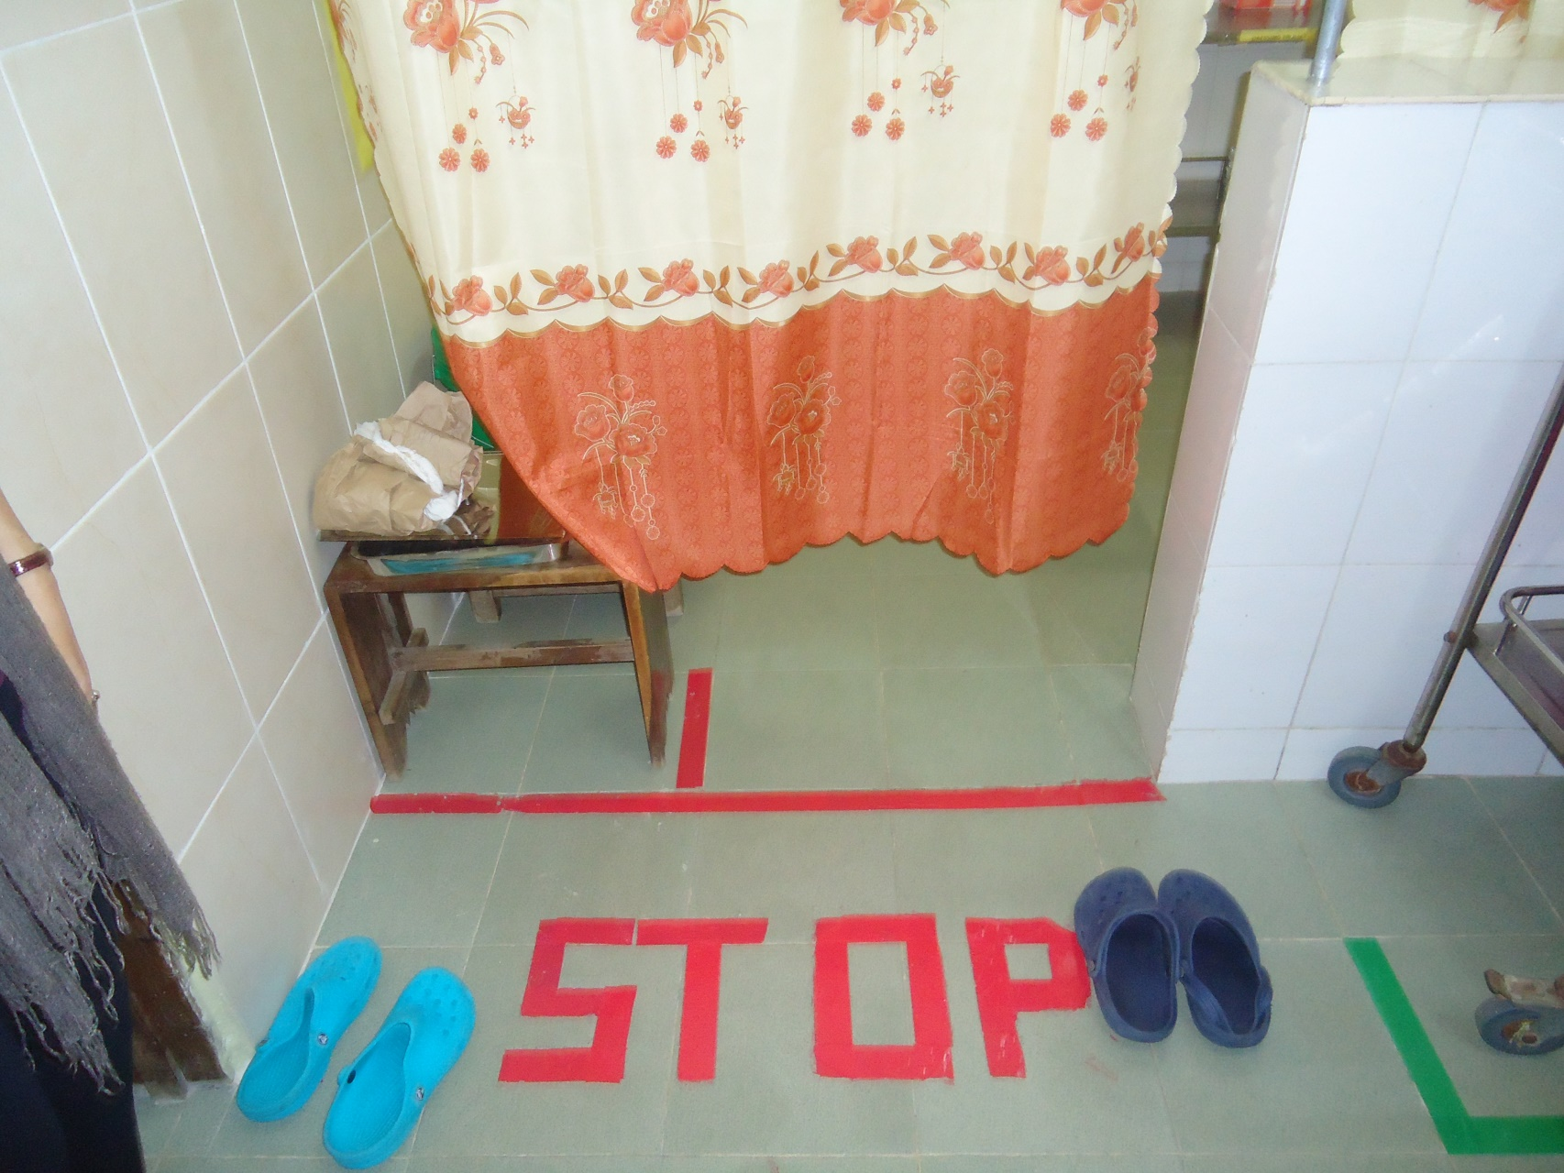
Hospitals in Tanzania

Slide 38
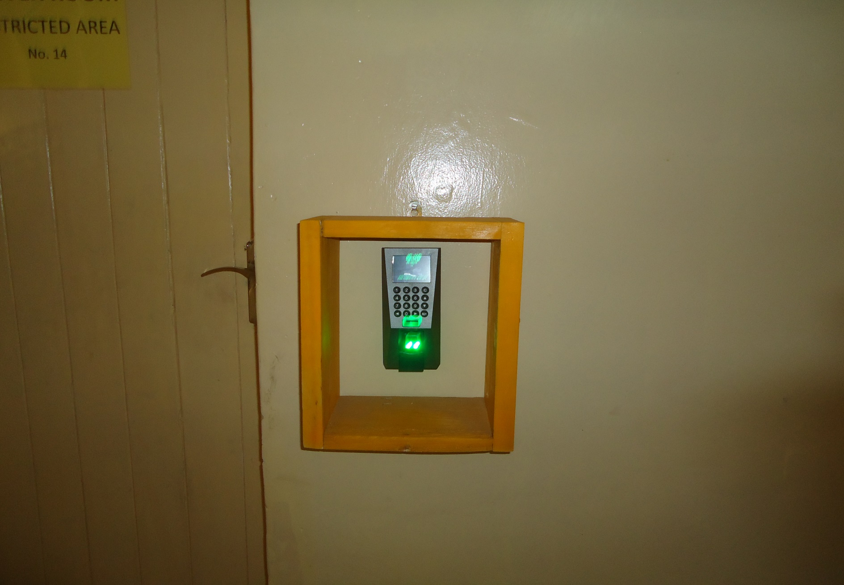
Hospitals in Tanzania

Slide 39
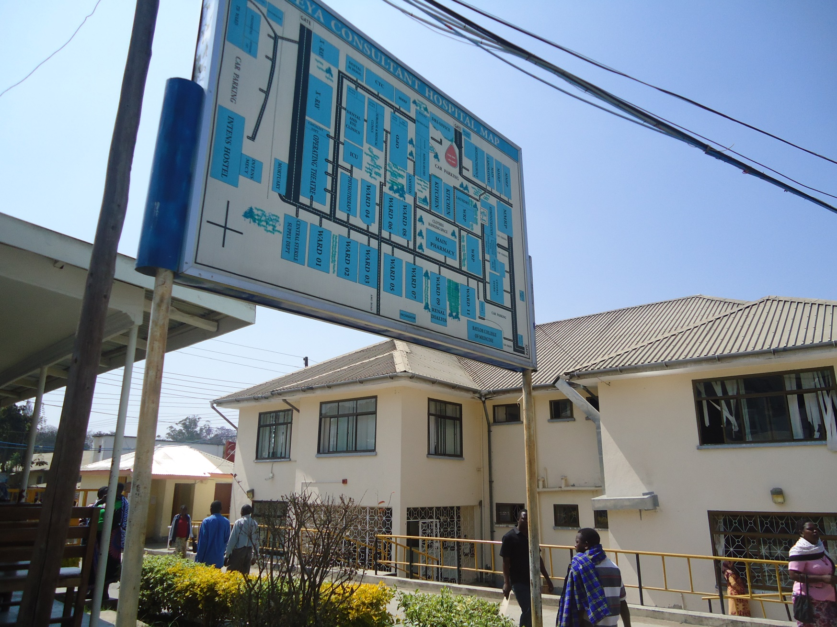
Hospitals in Tanzania

Slide 40
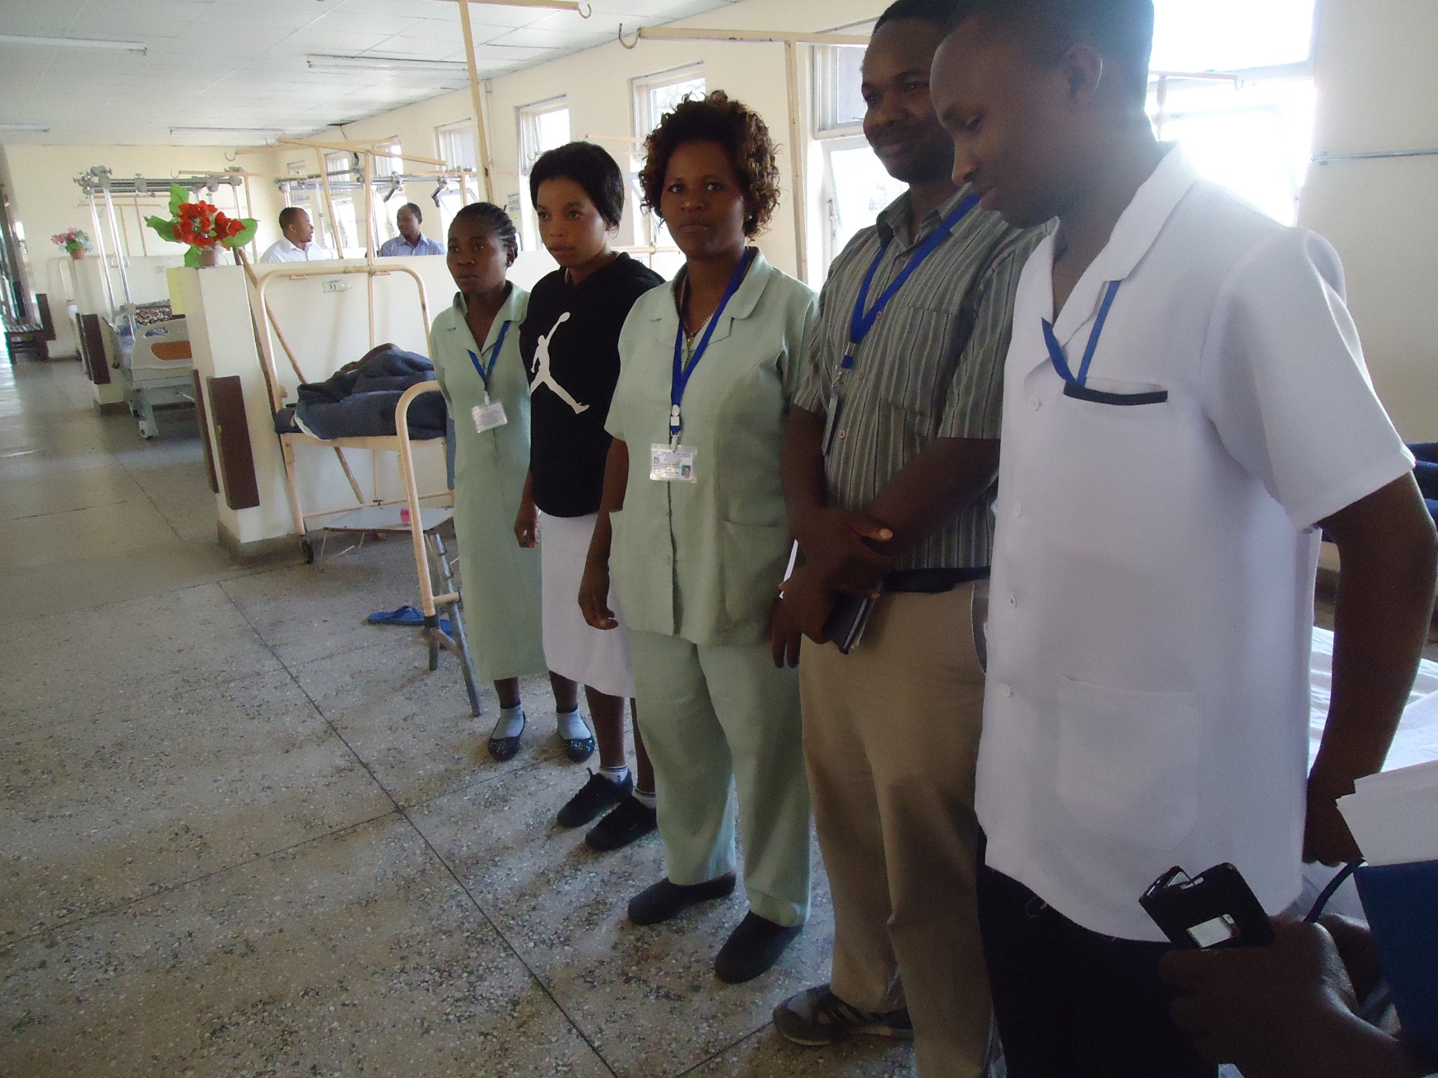
Hospitals in Tanzania

Slide 41
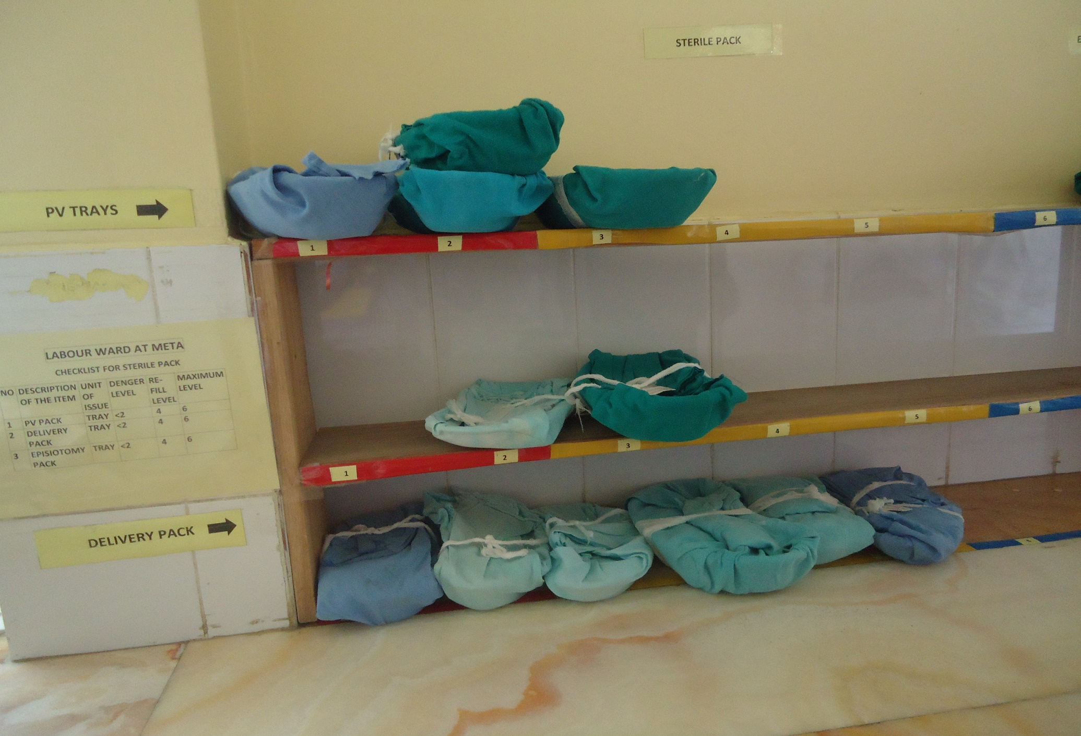
Hospitals in Tanzania

Slide 42
Thank You

